Slide 3
Strategic Risk Management: Using captives for more effective risk management and to advance strategic initiatives
Moderator:
Michael Serricchio, Senior Vice President, Captive Solutions
Marsh USA Inc.
Michael.serricchio@marsh.com
Speakers:
Keith W. Kennerly
Vice President
Structured Health & Financial Solutions
Hannover Re
keith.kennerly@hlramerica.com
John Jureller
Executive Vice President &
Chief Financial Officer
Frontier Communications
john.jureller@ftr.com
Jay Green
Senior Vice President
GC Securities
Guy Carpenter & Company
jay.green@guycarp.com
P. Bruce Wright
Partner
Sutherland Asbill & Brennan LLP
bruce.wright@sutherland.com

Slide 4

Agenda
Captive Trends
  Counting Captives & Non-Traditional Captive Growth
Captive Types and Size
Captive Coverages: Traditional and Non-Traditional
  How to Expand a Captive and Preserve Capital
A Captive Owner’s Perspective on Cost Saving and Capital Management
Accessing Alternative Forms of Capital through Insurance Linked Securities, and CAT Bonds
Alternative Uses of Capital

Slide 5
Here With You Today
John Jureller, EVP & CFO, Frontier Communications
  CT Captive #4!!!
Keith W. Kennerly, VP, Structured Health and Financial Solutions, Hannover Re
  Insurer’s Perspective on Non-Traditional Captive Vehicles
Jay Green, SVP, GC Securities / Guy Carpenter
  CAT Bonds
P. Bruce Wright, Partner, Sutherland Asbill & Brennan LLP
  Alternative Uses of Capital
Michael Serricchio, Senior Vice President, Marsh Captive Solutions
  Moderator

Slide 6
Number of Captives Worldwide
Source: BI Survey, “Total Captives Worldwide,” Business Insurance, March 17, 2014: 24
*Numbers restated by BI.

Slide 7
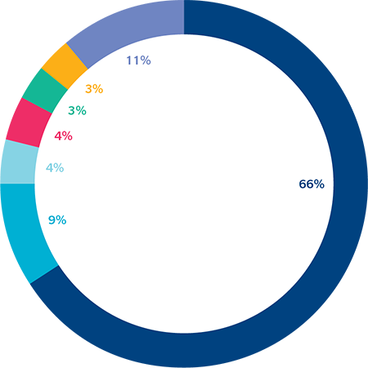
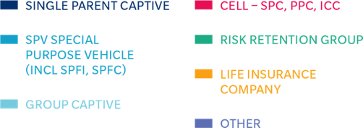
Type of Risk-Financing Vehicle
Representing 66% of the total captive count, single parent captives continue to be the preferred structure of captive owners.
Special purpose vehicles (SPVs) accounted for 9% of the benchmarked captives.
  SPVs include life, XXX, ILS/SPI, etc.
  Marsh saw its overall portfolio of SPV companies grow during 2013, and now manages more than 108 of such entities.
  This is a Growth area.
Source: Marsh’s Benchmarking Survey Analysis 2014

Slide 8
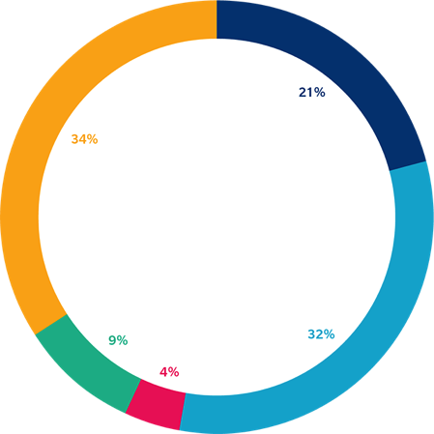
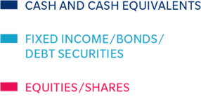
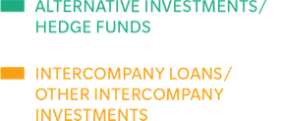
Aggregate Investment Type for All Captives
Since the credit crisis, a large proportion of captives have entered into intercompany investments with their parent company and affiliates
  This allows companies to use their capital efficiently with no opportunity costs
Fixed income assets come in a close second with 32%, reflecting the preference of captive owners for investments with low volatility to preserve capital.
Source: Marsh’s Benchmarking Survey Analysis 2014

Slide 9
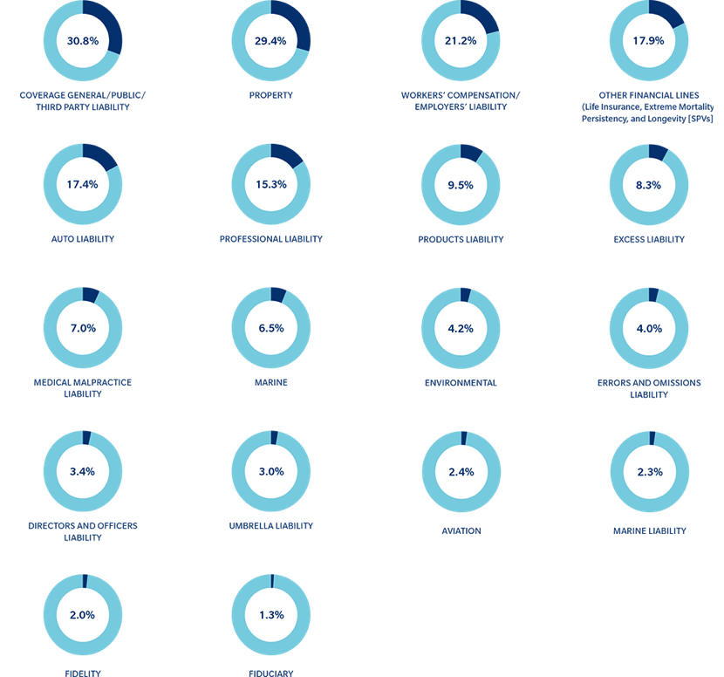
Traditional Insurance Coverage Written by Captives
The top five coverages included in captives are no surprise:
  Third party liability;
  Property;
  Workers’ Compensation;
  Auto liability;
  Professional liability;
  WHAT LIES AHEAD?
Source: Marsh’s Benchmarking Survey Analysis 2014

Slide 10
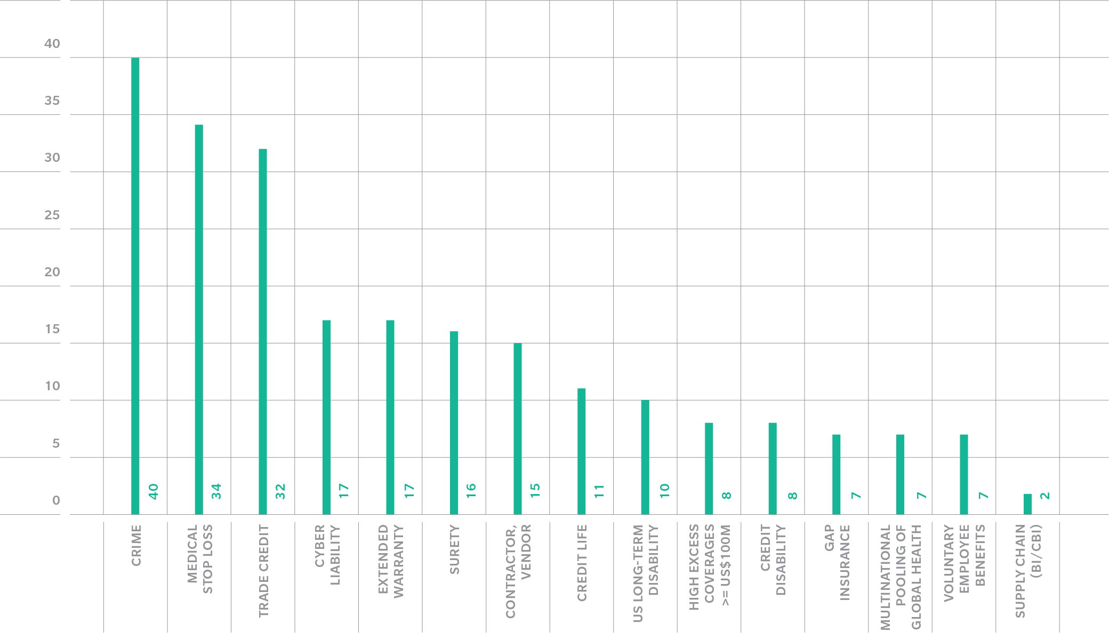
Non-Traditional Insurance Coverage Written by Captives
Source: Marsh’s Benchmarking Survey Analysis 2014

Slide 11
Risk Managers Eye Cyber Risk
Business Insurance survey* reported that 56% of Risk managers surveyed cited Cyber Risk as a “Top Concern”
52% of Risk Managers said they had a dedicated Cyber Risk Insurance Policy
  38% Said NO
  10% were unsure!
* Source: Business Insurance, February 17, 2014, Page 13
Notes:
Interesting to note here that half the group surveyed either have no CRIP or didn’t know…!!!

Slide 12

Frontier Communications
“A Captive to Support Capital Investment”
John M. Jureller, EVP & CFO

Slide 13
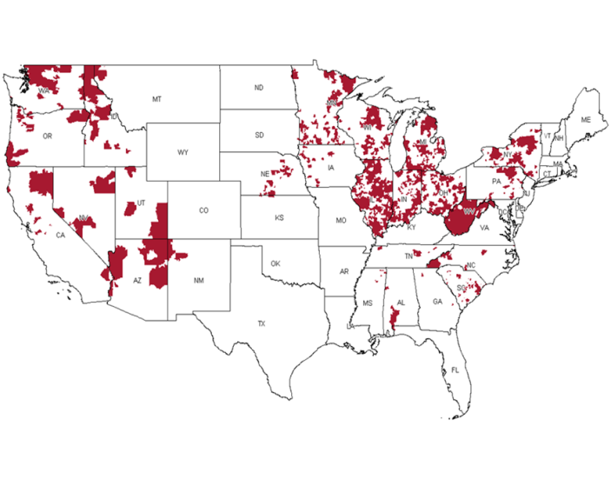
Frontier Overview
Key Statistics ⁽¹⁾ :
Broadband, voice, video, data security and advanced communications services for residential, business and carrier customers in 27 states
13,900 U.S.-based employees
7.2 million Residential households in footprint
2.8 million residential customers, 0.3 million business customers
Estimated 23% residential broadband market share
LTM Revenue = $4,667 million
LTM Adjusted EBITDA = $2,155 million (46.2% margin)
LTM Free cash flow = $931 million
Net Debt:Adj EBITDA leverage of 3.30x
$1.6 billion of cash & credit availability
Frontier Communications (NASDAQ: FTR) is the largest communications company predominantly focused on rural America
Frontier strategy is to “lead with broadband“ as the core component of its service offering and growth
Offers a variety of voice, data, video, and data security products to residential and business customers on a standalone or packaged solution basis
(1) as of 6/30/14

Slide 14
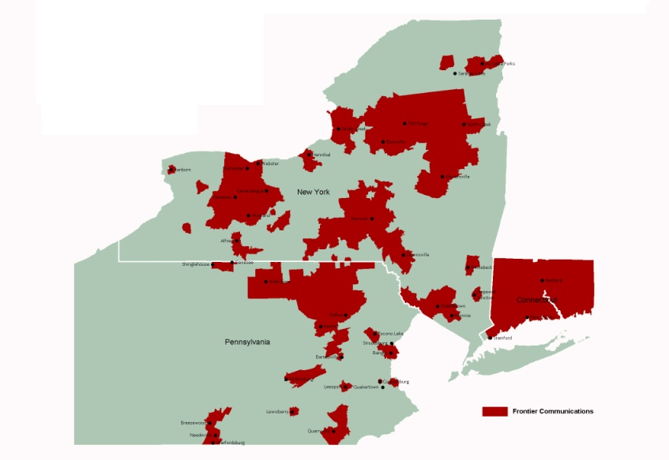
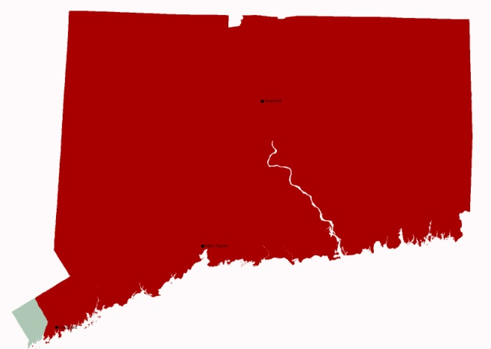
Connecticut Complements Frontier’s Existing Operations
Frontier’s New Northeast Region
Connecticut Addressable Base
(in thousands)
State Population | 3,590
State Households | 1,360
Rural | 48%
2011 Median Household income | $97K
Average age | ~40
High School Degree | ~89%
Bachelor Degree and above | ~36%
Voice Connections ¹ | Approx. 875,000
Broadband Connections ¹ | Approx. 415,000
Video Connections ¹ | Approx. 215,000
Est. Video availability (% of Living Units) ² | 47.0%
Wire Centers (total) | 127
Notes:
as of 6/30/14
Per AT&T PURA filing

Slide 15
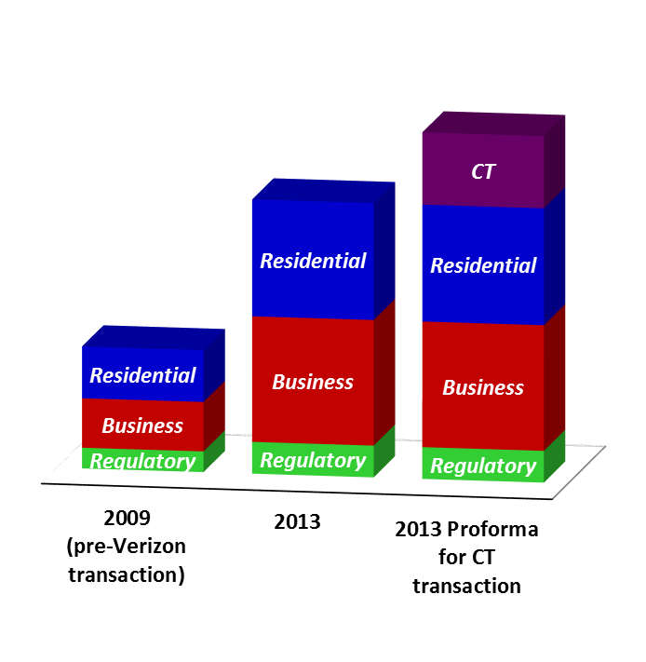
Frontier is a S&P 500 Company and the 4th largest Incumbent Local Exchange Carrier
Revenue ($ millions)
$6,011
$4,762
$2,118

Slide 16
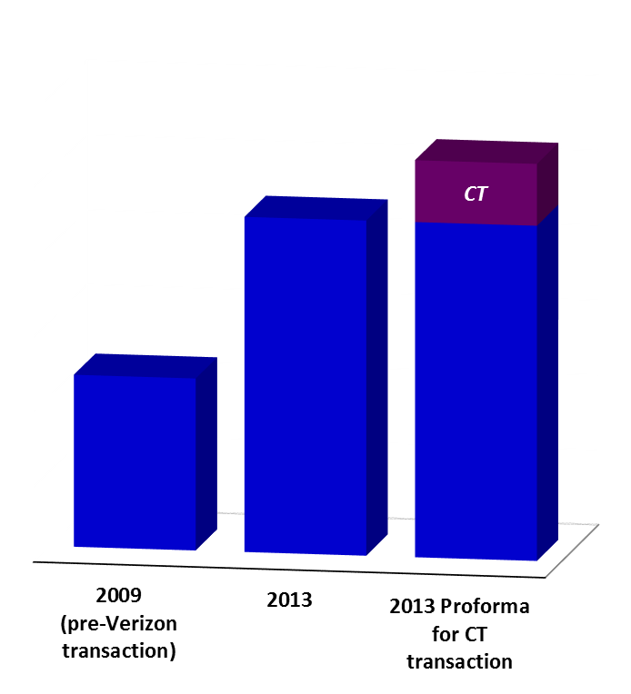
…with strong EBITDA
$2,614
$2,238
$1,149
($ millions)

Slide 17
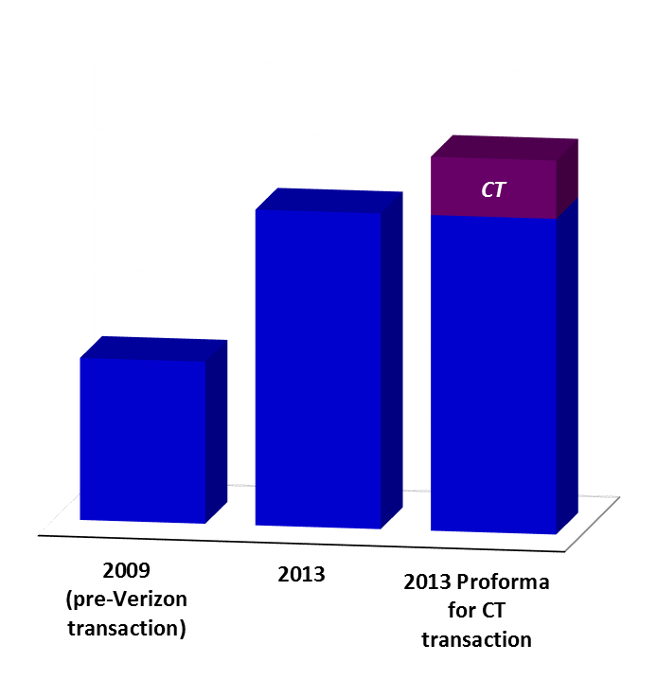
…that supports substantial annual CapEx investment
$782
$635
$256
($ millions)

Slide 18
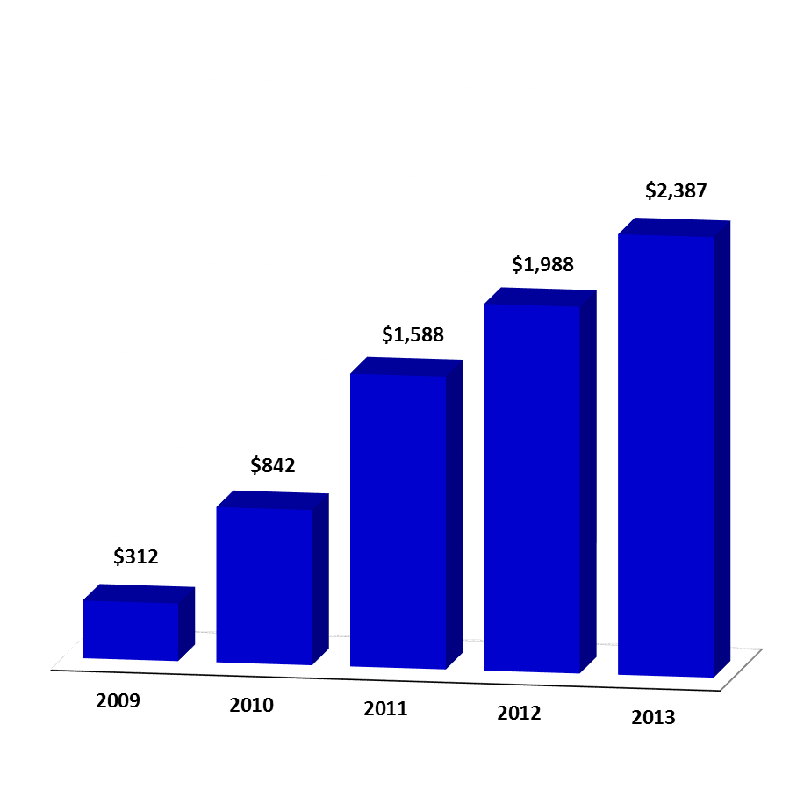
…and provides a valued dividend return to our shareholders
Cumulative Dividends 2009-2013 ($ millions)

Slide 19
Our financial opportunities are led by our business opportunities
Residential consumer
  Gaining market share – Frontier took share from cable in 82% of our local markets in H1’14
  Driving growth in broadband (data) revenue to exceed declines in traditional voice revenue
  Increasing video share in FiOS markets (and U-verse in CT)
  Providing value added services (e.g. Frontier Secure)
Business
  A robust, high quality network to serve small carrier / enterprise customers
  Gaining market share in small / medium customer base
Keep customers by delivering a high quality service at a competitive price

Slide 20
Captive Insurance benefits….
Risk visibility
Manage premium loading
Reinsurance market access
Importantly, Frontier also considers…
Financial benefits to unleash additional capital investment
These are the benefits that are often discussed

Slide 21
Frontier’s capital opportunities are….
Network Investment for the expansion / enhancement of service capabilities
  > $2.7 billion of capital investment for the 2011 – 2014E⁽¹⁾ period
  Focus on strengthening a high-quality Broadband network for Residential and Business Customers
Operational Investment to provide for continuing high-quality customer experience
  Technician field support
  Call centers
  Customer help desks
Balance sheet / Capital management
(1) Based upon the midpoint of Frontier’s public guidance; excludes CT acquisition

Slide 22
In Summary…
Frontier’s Captive Insurance Sub is an important element of enhancing shareholder value
…and we will continue to explore how the Captive can be effectively used to support Risk Management and unlock Capital for investment in it’s business
(1) Based upon the midpoint of Frontier’s public guidance; excludes CT acquisition

Slide 23
Hanover Re
  “Insurer’s Perspective on Non-Traditional Captive Vehicles”
Keith W. Kennerly, VP, Structured Health and Financial Solutions

Slide 24
Introduction
. . .captives are created to insure/finance blocks of internal business
Captives: What is financed and Why?
Reduce Expose to businesses with low or volatile ROE
Release Embedded Value related to Surplus Capital
Release Excess Capital attributed to Regulatory Reserve Requirements
24

Slide 25
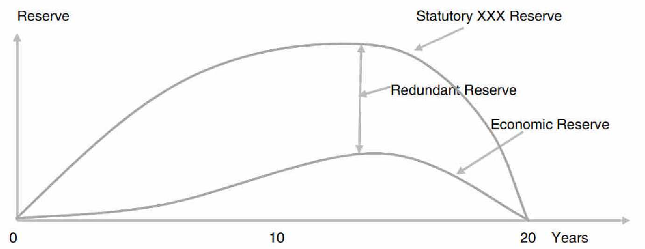
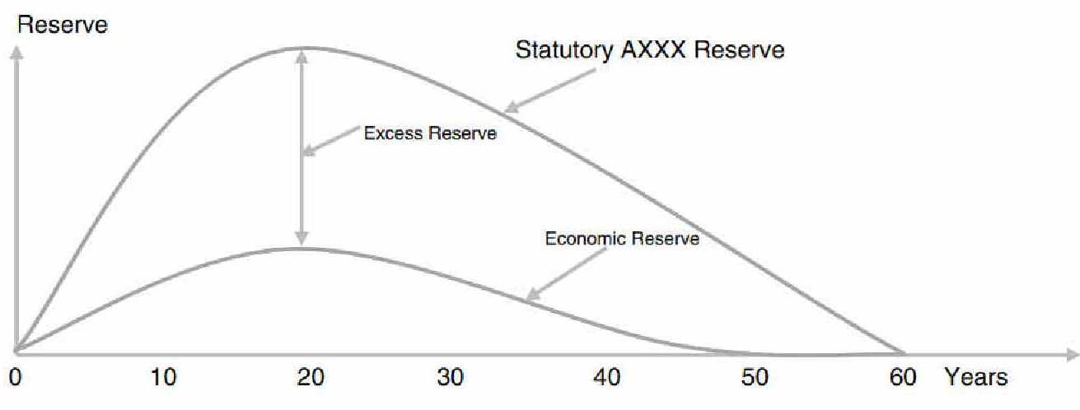
Regulatory Reserve
. . .illustrations of actuarial reserve redundancies
Term Life Insurance (XXX)
Universal Life Insurance (AXXX)
25

Slide 26
Brief History
. . . initial captive reinsurance solutions
Ancient History – Fully Funded and Wrapped Deals
  Closed Block Securitizations
Triple-X Securitizations
AXXX Securitizations
Long-Term Disability Securitization
26

Slide 27
Brief History (continued)
. . .emergence of captives with unwrapped solutions
Advent of Structured Letters of Credit (LOCs)
  Full Recourse (unconditional parent guarantee)
  Limited Recourse (conditional parent guarantee)
  Non-Recourse (supported by cash flows only)
  In addition to an obligation to reimburse amounts drawn, the parent might be required upon certain adverse events to post collateral or contribute additional capital to the captive
27

Slide 28
Brief History (continued)
. . .development of other captive solutions
Note Structures
Surplus for Capital Note Exchange supported by:
  Reinsurer-Backed Note (RBN)
  Puttable Notes
  Variable Funding Notes
  Liquidity Facilities and other Contingent Capital
Stop Loss Retrocession
28

Slide 29
Basic Structure for Captive Reinsurance
Excess
Claims
Sponsor
Initial
Premium
Collateral B
(Redundant Reserves)
Claims
Collateral A
(Economic Reserves)
Reinsurance
Agreement
$
Captive Re
Financing Source(s)
Traditional Reinsurer
Banks
Capital Markets
29

Slide 30
Bank Financed Transaction
. . . with and without recourse from Parent Company
For the Benefit of
Sponsor
Sponsor
For the
Benefit of
Sponsor
Reinsurance
Contract
Captive Re
Reinsurance
Trust
Bank
Letter of
Credit
Reimbursement Obligation
Guaranty
(optional – subject to recourse)
Parent
Company
30

Slide 31
Note Structures
Sponsor
Captive Re
Note Issuer
Reinsurance
Surplus Notes
Capital Notes
Collateralized Reinsurance
Mortality Swap
Puttable Notes
Variable Funding Notes
Liquidity Facilities and other Contingent Capital
Traditional
Reinsurer or
3rd Party Risk Taker(s)
31

Slide 32
Retrocession
Sponsor
Coinsurance/Funds Withheld
Reinsurance Agreement
Captive Re
Surplus Notes
Capital Note Issuer
Capital Notes
Stop-Loss / YRT
Retrocession
Agreement
(Excess Reserves Only)
Traditional
Reinsurer or
3rd Party Risk Taker(s)
32

Slide 33
Regulatory Scrutiny
Current Articles/Debates
NAIC Responses
The Rector Report
33

Slide 34
Guy Carpenter
  “CAT Bonds”
Jay Green, Senior Vice President, Guy Carpenter Securities

Slide 35
Insurance-Linked Securities
GC Securities is the specialist investment bank of Guy Carpenter and facilitates the transfer of property, casualty and life risks to the capital markets for our insurance and reinsurance clients in multiple formats (generally referred to as “ILS” or “Insurance-linked Securities”):
  Catastrophe Bonds
  Derivatives
  Collateralized Reinsurance
  Sidecars
The ILS team is fully integrated into the Marsh and Guy Carpenter brokerage platforms offering our clients seamless capital markets execution within traditional risk transfer programs based on close coordination with broker teams and detailed knowledge of client

Slide 36
Insurance-Linked Securities
Spectrum of Solutions
Full Spectrum of Capital Solutions
Shorter Term
Longer Term
Traditional / Collateralized Reinsurance
Indexed Products
(ILW / CWIL)
Insurance Linked
Securities
(Cat bonds)
Third Party Capital (Sidecars)
Debt
Preferred or Equity Linked Capital
Equity
Collateralized Reinsurance
Indexed Products
(Industry Loss Warranties)
Insurance Linked Securities
(Catastrophe Bonds)
Third Party Capital
(Sidecars)
Traditional reinsurance program placed with capital markets investors posting full collateral
Typically relies on traditional contract forms with modifications for collateral structure and commutation mechanism
Term: 1 year
A reinsurance contract with an Indexed-based trigger using insured industry losses (i.e. PCS for U.S. Hurricane) estimates post-event
Typically structured as an excess of loss contract covering specific perils
Term: 1 year
Securities offered through a special purpose vehicle to raise capital for future claims paying obligations under risk transfer agreement with the protection buyer
Typically structured as an excess of loss contract covering specific perils on a defined book of business
Term: 3-5 years
A special purpose reinsurer that assumes a portion of the ceding company’s underwriting risk in exchange for a portion of the underwriting premium
Typically structured as a quota share arrangement on a defined book of business
Term: 1-2 years
36
Notes:
36

Slide 37
Insurance-Linked Securities
Strategic Benefits
Capital markets-based risk transfer capacity is a complementary tool to work in conjunction with any traditional (re)insurance tools
Advantages
  Multi-year capacity (for catastrophe bonds) at rates defined at inception
  May lower rate volatility (i.e. less dependence on the market cycles) due to its multi-year structure
  Fully collateralized protection
  Diversify claims paying resources and can provide meaningful capacity
  Liquidity if non-indemnity trigger is utilized
  Guarantee of annual premium is only for the first year
    If the limit is reduced after the first year, the ROL is based on the amount of coverage limit at the beginning of each quarter with no guaranteed annual premium required
Additionally, the use of alternative markets such as the catastrophe bond market (or alternative capital markets capacity) can be used as leverage in negotiations with traditional insurance providers
Notes:
37

Slide 38
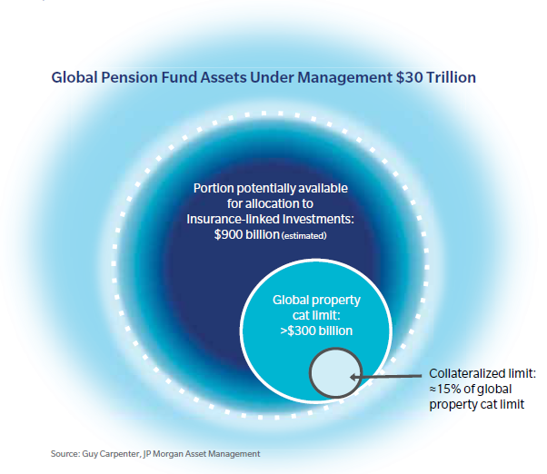
Insurance-Linked Securities
Capital Markets-Based Capacity Growth Potential
38
38
Notes:
38

Slide 39
Insurance-Linked Securities
Capital Markets-Based Capacity….2013 & Beyond
Estimated 2013 Capacity Composition
Global property catastrophe limit purchased is estimated at $316bn
The non traditional market capacity is projected to grow to $60bn, by 2016
  Majority of this growth is expected to be seen in the catastrophe bond and collateralized reinsurance segments
Many reinsurers are responding to this competitive threat by establishing new 3rd party managed account divisions
  Leverage their underwriting expertise and access to business
  Offer managed account facilities to new capital investors
  Recruiting capital markets professionals
Source: Guy Carpenter & Company LLC; GC Securities
39
39
Notes:
39

Slide 40
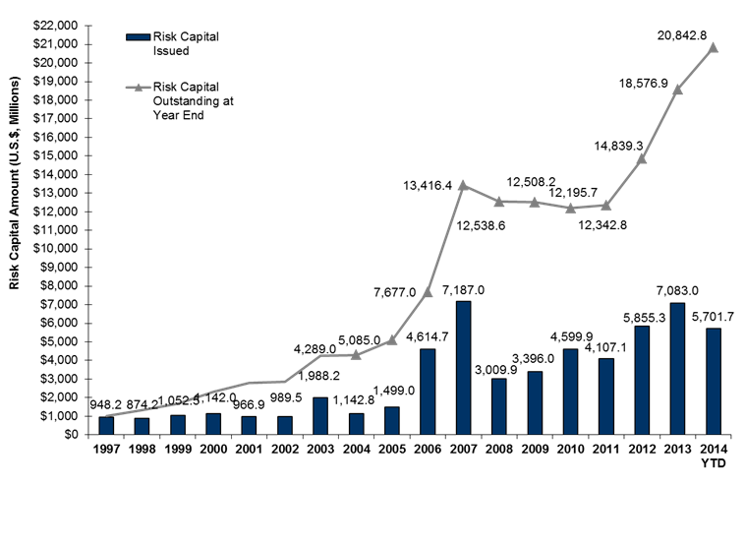
Insurance-Linked Securities
Annual Cat Bond Issuance
Based on GC Securities proprietary database as of July 31, 2014.
40
40

Slide 41
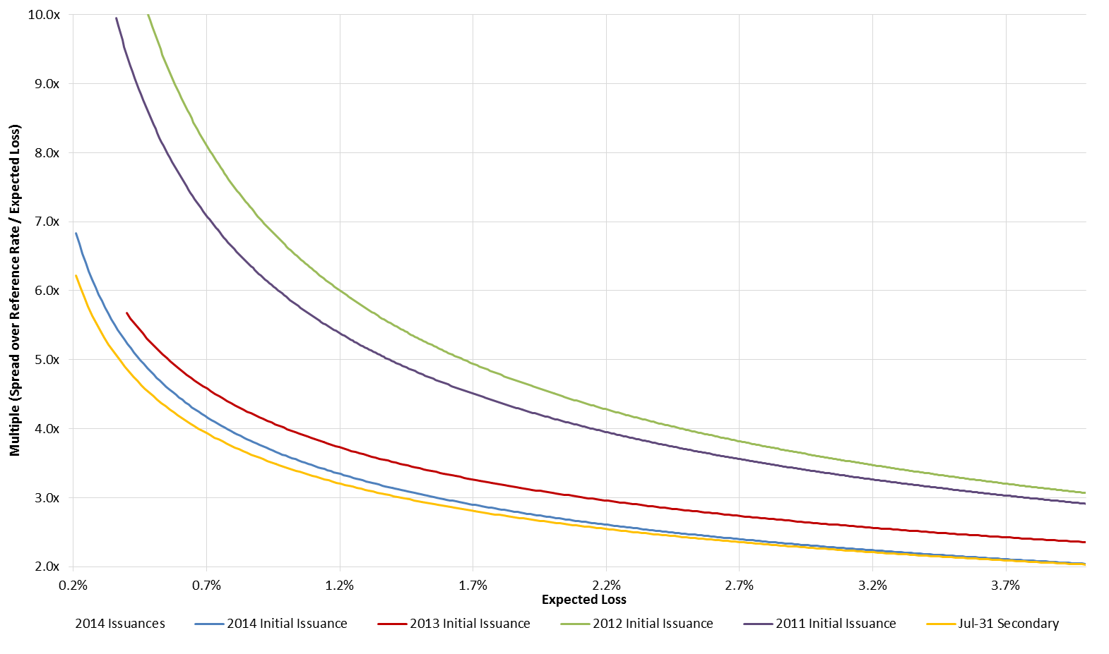
Insurance-Linked Securities
Cat Bond Pricing Trends
All forms of capital markets capacity has experienced pricing shift in a similar manner to the 144A catastrophe bond marketplace
2012 to
2013:
-25-50%
YOY
2013 to 2014YTD:
-15-25%
YOY
Source: GC Securities
41
41

Slide 42
Insurance-Linked Securities
Basic Cat Bond Structures
There are two basic catastrophe bond structures: (1) transformer structure or (2) direct structure
Transformer via Captive or (Re)insurer Structure
Direct to SPV Structure
Sponsor
Insurance
Contract
Captive or Traditional
(Re)insurer
Sponsor
Premium
Pledge of
Collateral to support obligations of the Traditional Reinsurer
Premium
Derivative or
Reinsurance Contract
Premium
Protection
Contract
Outstanding
Principal
Amount
at maturity
Outstanding
Principal
Amount
at maturity
Dedicated
Reinsurer
(SPV)
Dedicated
Reinsurer
(SPV)
Collateral
Solution
Institutional
Investors
Collateral
Solution
Institutional
Investors
Reference Rate & Return of original investment principal
Collateral Account
$
Reference Rate & Return of original investment principal
Collateral Account
$
Interest Payments = Reference Rate + Spread
Interest Payments = Reference Rate + Spread
42
Notes:
42

Slide 43
Insurance-Linked Securities
Key Coverage Features
Perils
Lines of Business
Types of Coverage
Triggers
  Typically ‘Named Perils’ only
  Modeled by third-party venders (eg AIR, RMS, EQECAT)
  Personal lines property cat
  Commercial lines property cat
  Energy & Marine
  Workers comp cat
  Life risks (mortality and longevity)
  General liability risks
  Per occurrence cat excess of loss
  Aggregate cat excess of loss
  Quota share
  Sideways / frequency cover
  Per risk
  Facultative
  Parametric
  Modeled loss,
  Industry loss index (PCS/PERILS)
  Indemnity

Slide 44
Sutherland Asbil & Brennan LLP
  “Alternative Uses of Capital”
P. Bruce Wright, Partner

Slide 45
UTILIZATION OF EXCESS INVESTMENT ASSETS TO MONETIZE CREDIT CARD/TRADE RECEIVABLES
INTERESTS
IN TRUST
TRUSTEE
OBSERVATION
  ASSETS ARE OBLIGATIONS OF THIRD PARTIES
CASH
CREDIT CARD RECEIVABLES
CASH
INTERESTS
IN TRUST
INVESTORS
CASH
INSURED
CAPTIVE

Slide 46
UTILIZATION OF EXCESS CAPTIVE ASSETS TO MONETIZE OTHER THIRD PARTY ASSETS
LESSEES
LEASE PAYMENTS
OBSERVATION
  ASSETS ARE OBLIGATIONS OF THIRD PARTIES
INSURED
LEASE EQUIPMENT AUTOS ETC.
ASSIGN LEASES SUBJECT TO MANAGEMENT OBLIGATION
100%
CASH
CAPTIVE

Slide 47
UTILIZATION OF CAPTIVE AS CASH MANAGEMENT FACILITY
PARENT
INSURED
OBSERVATION
  LIQUIDITY
  PASS THROUGH FOR TAX PURPOSES
  LLC ASSET OF CAPTIVE
S1
S2
S3
S4
CAPTIVE
OPERATING SUBSIDIARIES
EXCESS CASH & INTEREST ON ADVANCES
DISREGARDED ENTITY
FOR TAX PURPOSES
ADVANCES
LLC ASSETS REPOSITORY

Slide 48
ASSETS INVESTED IN COMMERCIAL PAPER
OF PARENT
OBSERVATION
  LIQUIDITY
CASH
PARENT INSURED
COMMERCIAL
PAPER
COMMERCIAL
PAPER
CAPTIVE
CASH

Slide 49
REGULATORY/STATE & FEDERAL TAX ISSUES
FEDERAL TAX CONSEQUENCES
  DEDUCTION OF PREMIUM
  LOANBACKS / LIQUIDITY
    IRS POSITION
    RENT-A-CENTER CASE
  CONCENTRATION OF INVESTMENT RISK
  TREATMENT OF OUTWARD “PARAMETRIC” REINSURANCE/RETROCESSION

Slide 50
REGULATORY/STATE & FEDERAL TAX ISSUES
STATE TAX CONSEQUENCES
  COMBINING INCOME ISSUE AFFECTS PARENT NOV CAPTIVE IS IN ANOTHER STATE
APPORTIONMENT FACTOR
COMBINED
INCOME
RATE
X
X
    ■ ISSUE ARISES BECAUSE OF PARENT DOING BUSINESS IN STATE NOT LOCATION OF CAPTIVE

Slide 51
REGULATORY/STATE & FEDERAL TAX ISSUES
STATE TAX CONSEQUENCES
  NEW YORK RULE RE: OVER-STUFFED CAPTIVES/FEDERAL RULES APPLY
  BUT SEE WENDY’S CASES IN ILLINOIS AND OKLAHOMA
      DEALING WITH EXCESS INVESTMENT INCOME
        CATASTROPHE EXPOSURES, e.g., EXCESS D&O, EXCESS E&O
        PRIMARY EXPOSURES
REGULATORY ISSUES
  LIQUIDITY

Slide 52
Disclosure
Securities or investments, as applicable are offered in the US through GC Securities, a division of MMC Securities Corp. (“MMCSC”), a US registered broker-dealer and member FINRA/SIPC. Main office: 1166 Avenue of the Americas, New York, NY 10036. Phone: 212.345.5000. Securities or investments, as applicable are offered in the European Union by GC Securities, a division of MMC Securities (Europe) Ltd., which is authorized and regulated by the Financial Services Authority. Reinsurance products are placed through qualified affiliates of Guy Carpenter & Company, LLC. MMC Securities Corp., MMC Securities (Europe) Ltd., and Guy Carpenter, LLC are affiliates owned by Marsh & McLennan Companies (“MMC”). Reinsurance intermediary services are offered through Guy Carpenter & Company, LLC.
This information was prepared by MMCSC and/or Guy Carpenter & Company, LLC. (“Guy Carpenter” or ”GC”), the reinsurance brokerage arm of MMC. All statistical tables, charts, graphs or other illustrations contained herein were prepared by MMCSC or GC unless otherwise noted. Results from simulations and projections are for illustrative purposes only and are based on certain assumptions. Therefore the recipient should not place undue reliance on these results. Past performance does not guarantee future results.
Neither MMCSC nor GC is a legal, tax or accounting adviser and makes no representation as to the accuracy or completeness of any data or information gathered or prepared by MMCSC or GC hereunder. Your company should therefore consult with its own tax, accounting, legal or other advisers and make its own independent analysis and investigation of the proposed transaction, as well as the financial and tax consequences thereof, the creditworthiness of the parties involved and all other matters relating to the transaction, prior to its own independent decision whether or not to enter into any agreements in connection with any transaction.
This document contains indicative terms for discussion purposes only. MMCSC and GC give no assurance that any transaction will be consummated on the basis of these indicative terms and no specific issuer is obligated to issue any security or instrument on such indicative terms. This presentation does not constitute an offer to sell or any solicitation of any offer to buy or sell any security or instrument or to enter into any transaction on such indicative terms. An investment in insurance linked securities is speculative, involves a high degree of risk and should be considered only by institutional investors who can bear the economic risks of their investments and who can afford to sustain the loss of their investments. Noteholders may lose all or a portion of their investment. Institutional investors should thoroughly consider the information contained herein.
This document is not intended to provide the sole basis for any evaluation by you of any transaction, security or instrument described herein and you agree that the merits or suitability of any such transaction, security or instrument to your particular situation will be independently determined by you including consideration of the legal, tax, accounting, regulatory financial and other related aspects thereof. Opinions and estimates constitute MMCSC’s and/or GC’s judgment and are subject to change without notice. In particular, neither MMCSC nor GC owes duty to you (except as required by the rules of the Securities and Exchange Commission, Financial Industry Regulatory Authority, Financial Services Authority, and/or any other regulatory body having proper jurisdiction) to exercise any judgment on your behalf as to the merits or suitability of any transaction, security or instrument. The information contained herein is provided to you on a strictly confidential basis and you agree that it may not be copied, reproduced or otherwise distributed by you (other than to your professional advisers) without our prior written consent.
This material provides general and conceptual information about certain financial strategies, and does not discuss or refer to any specific securities or other financial product. This presentation is not intended as marketing, solicitation or offering any security or other financial product in Japan. This material is intended only for sponsors, financial intuitions and qualified investors.
MMCSC and/or GC may have an independent business relationship with any companies described herein.
Trademarks and service marks are the property of their respective owners.
The source of information for any charts, graphs, or illustrations in this document is GC Securities Proprietary Database 2013, unless otherwise indicated.
Cory Anger, Chi Hum, Geoff Sweitzer, Ryan Clarke, Jay Green, and Sung Yim are registered representatives of MMCSC.
Notes:
52

Slide 53
Risk Mitigation Strategies: Improve the Captive’s Financial Performance and Support Operational Objectives
Moderator:
Noreen E. Kuziak, Director of Underwriting, The Hartford Steam Boiler
noreen.kuziak@hsb.com
Speakers:
Nick Pearson
Partner,
Edwards Wildman Palmer, LLP
npearson@edwardswildman.com
Robert J. Blackburn
Managing Director &
Principal,
Blackburn Group, Inc.
rblackburn@blackburngroup.com

Slide 54
It’s What You Don’t Know…
that can really hurt your captive’s performance.
Or make you miss opportunities!
Today’s Focus:
Ways to help you ‘get in the know’ and understand how your captive operates
Nick – Strategies that captive owners can use, such as risk “incubation” and use of reinsurance.
Bob - How to correlate your captive’s data against events that occur. The results are powerful!

Slide 55
Our Focus Today: Helping You Understand Your Captive’s Performance
Captive
RM Strategies
Big Data Analytics
In The Know

Slide 56
Reasons to Form a Captive
Combination of financial and operational objectives
4 ”c’s”
  Cost
  Coverage
  Control
  Capacity

Slide 57
Strategies to Enhance Financial Performance and Support Operational Objectives
Captive Consolidation
Risk “Incubation”
Use of Sponsored Captives
Opportunistic Use of Reinsurance
Tighten and Integrate Loss Control Practices

Slide 58
Captive Consolidation
Multiple captives often result from M&A activity
  Duplication of administrative costs
  Unnecessary deployment of capital to support individual captive financial requirements
  Adds to internal administrative burden on company personnel
  Impedes loss control strategy
  Merger into a single Connecticut captive
  Merger process straightforward
  Connecticut Department has already dealt with the merger of foreign captives into a Connecticut captive
  All policyholders’ assets and liabilities of the merged captive will move to the surviving Connecticut captive

Slide 59
Risk Incubation
Non-traditional risks often difficult to place in the insurance market due to lack of data and familiarity
Captives can develop specific policies to address owners new or unique risks and “incubate them”
Reinsurance markets accessible by the captive are often more willing to offer capacity for these risks based on recognition of owner’s:
  Retained exposure through its captive (“skin in the game”)
  Knowledge and control over its own operations
  Use of captive can encourage a company to be innovative in products or services development
Over time, captive will accumulate experience and data which can be used to support underwriting submissions to the primary and reinsurance markets

Slide 60
Sponsored Captives
  Connecticut’s captive law provides for “Sponsored Captives”
  Formed and operated by one or more sponsors approved by Connecticut Department that fund their liabilities to each participant through protected cells with segregated assets
Owners of a cell in a sponsored captive can use that to segregate related liabilities from those in wholly owned captive
Can be used for start-up captive operations without costs associated with establishing wholly owned captive
  Can transfer risks over to wholly owned captive at a later date by assumption and novation

Slide 61
Opportunistic Use of Reinsurance
Captives ability to access global reinsurance market reduces total cost of risk financing
Take advantage of pricing opportunities in the reinsurance market
“Reinsurers are being paid less and less to bear risk” A.M. Best

Slide 62
Loss Control Practices
Better management of risk is a primary purpose for forming a captive
Captive owner knows its own business risks best and how to mitigate them
Self-funding risk through captive encourages proactive risk management through focus and data capture – “You can’t manage what you don’t measure”
Successful captive programs result in loss reduction with associated savings in loss costs and risk financing

Slide 63
Claim Analytics and Professional Service Teams For Value Creation

Slide 64


Quote from Peter Hancock, CEO of AIG
AIG wants to “manage down the cost of risk“ by analyzing claims data
Over 23,000,000 Workers Compensation claims
Recently appointed a Chief Science Officer to lead a staff of 130 team members, many of them Ph.Ds
Source: WSJ, 8/29/14, “AIG's New CEO Looks to Data to Chart Insurer's Course”

Slide 65

Claim Analytics and Professional Service Teams
So how do Claim Analytics and Professional Service Teams create risk mitigation results and add value to Captives?
…here’s what we have learned…

Slide 66
The Drivers of Risk Cost are the “1%-5%ers”
One percent of chronic/legacy patients accounted for over 20% of all health care spending in 2011.
Five percent of patients accounted for 50% of overall health care costs.
Source: Agency for Healthcare Research and Quality, US Department of HHS

Slide 67
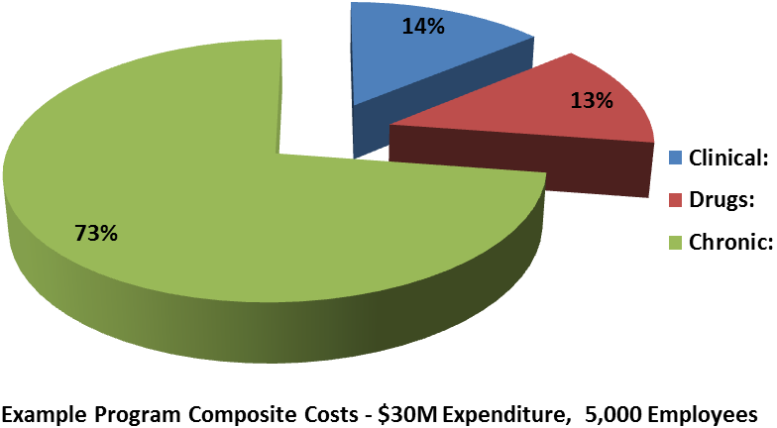
Captive Claim Cost Composition
Sources: Select “Mature Program” Casualty (Liability and Workers Compensation) and Health Blackburn Group, Inc. Proprietary Claim Data, Select Private Loss Cost Data, A.M. Best, Risk and Insurance Management Society, Advisen, and Business Insurance.
Notes:
IPO Road Show Presentation
9/19/14
67

Slide 68
Captive Risk and Claim Challenges
There are 13,000 International Classification of Diseases (ICD9) codes being used now
On October 1, 2015, CMS and the industry is adopting ICD10 codes of over 68,000 codes
8,800 Current Procedural Terminology (CPT) codes
Source: American Medical Association (AMA); AMA ICD Fact Sheet, September 2012; AMA Code Books

Slide 69
Become “Code” Focused for Risk Mitigation
Obtain all of the medical treatments including medications
Correlate the treatments to the occurrence
Compare the charges (bill review, then “best practice” analysis)
Negotiate the case

Slide 70
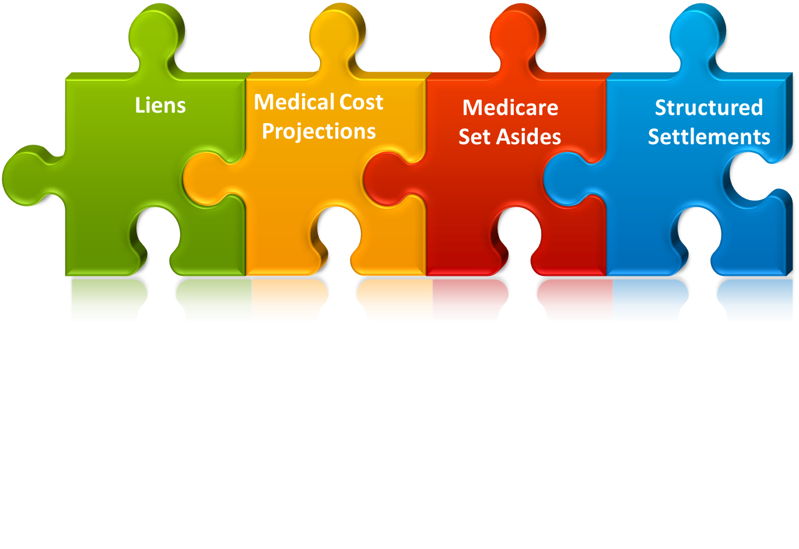
Key Integrated Solutions
Strategic integration cuts the administrative costs in half, and the damages by an average of 25% of the current ultimate reserves.
Notes:
IPO Road Show Presentation
9/19/14
70

Slide 71
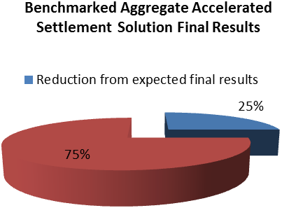
Risk Mitigation Case Study Project Results
Sources: Select “Mature Program” Casualty (Liability and Workers Compensation) and Health Blackburn Group, Inc. Proprietary Claim Data, Select Private Loss Cost Data, A.M. Best, Risk and Insurance Management Society, Advisen, and Business Insurance.
Notes:
IPO Road Show Presentation
9/19/14
71

Slide 72
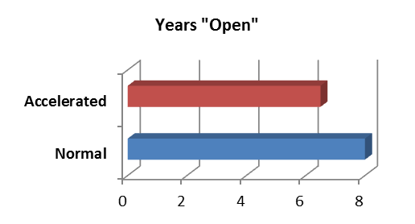
Risk Mitigation Case Study Project Results
Sources: Select “Mature Program” Casualty (Liability and Workers Compensation) and Health Blackburn Group, Inc. Proprietary Claim Data, Select Private Loss Cost Data, A.M. Best, Risk and Insurance Management Society, Advisen, and Business Insurance.
Notes:
IPO Road Show Presentation
9/19/14
72

Slide 73
How to Produce Risk Mitigation Results
Analyze the underlying causes of frequency and severity of loss (or expected loss)
Analyze cost drivers of the frequency and severity
Create Predictive Model with Continuous Monitoring components
Notes:
IPO Road Show Presentation
9/19/14
73

Slide 74
Predictive Modeling with Continuous Monitoring
Delivers an average 10-15 times return on investment in the products and services
Focus on Legacy/Chronic claims that drive the damage costs of Captive programs
Continuous monitoring, benchmarking and refinement throughout the process with dedicated technology and professional service teams
Notes:
IPO Road Show Presentation
9/19/14
74

Slide 75

The New Captive – A “Data Driven” Team
Immediately model the data for each occurrence
Separate the cases into “Clinical” v. “Chronic”
Assign teams
Notes:
IPO Road Show Presentation
9/19/14
75

Slide 76
Development & Execution of ”Enlightened” Strategies
Review past loss runs to determine the 5% of losses that create 50% of the claim costs
Order the losses from the most significant reserve to the least significant reserve
For each claim, obtain the last two years of medical information including treatments and medications
Notes:
IPO Road Show Presentation
9/19/14
76

Slide 77
Development & Execution of ”Enlightened” Strategies
Separate the information into occurrence and non-occurrence data
Benchmark the underlying codes to a “Best Practice” database
Execute the “occurrence” strategies by negotiating the liens then completing a cost projection
Structure the expected settlement costs based upon known benefits/best practice guidelines
Notes:
IPO Road Show Presentation
9/19/14
77

Slide 78

Conclusion
Data driven teams executing predictive models with strategic claim objectives drive risk mitigation results and value…

Slide 79
Strategies for Group Structures: Effectively meeting needs of affiliated or industry group businesses
Moderator:
Trung Khuu
Associate Director,
Strategic Risk Solutions, Inc.
trung.khuu@srsmail.com
Speakers:
Ed Malaspina
CMO, HAI Group & CEO of four HAI Companies
emalaspina@housingcenter.com
Jay Curtis
Vice President,
Willis Management (Vermont) Ltd.
jay.curtis@willis.com

Slide 80
Agenda
Discussion Points
  Background
  Group Captive Types
  Governance & Operations
  Group Captive Keys to Success

Slide 81
Background
Definition
  Group Captive (Risk Retention Group)
  An insurance company owned by two or more companies created to insure or reinsure the risks of its parents.
  Often times can be affiliated with a trade association or homogenous group of companies but heterogeneous group captives are also available and prevalent.
  Regulated under special legislation regulating captives (regulated less stringently than state insurance laws which govern fully admitted insurance companies).
  Risk Retention group is a specially designated group insurance structure formed under federal legislation allowing the company to function in states on an admitted (direct) basis.

Slide 82
Background (cont’d)
Definition
  Rent-a-Captive (RAC/Segregated Cell Captive/Sponsored)
  Organized to insure or reinsure the risks of unrelated shareholders; the insured are “renting” capacity of the insurer capitalized by outside sponsors
  Each insured utilizes underwriting “cell” within the overall company
  A separate legal entity can be formed by the insured or activity in cell may be governed by a participation agreement or preferred share arrangement
  Often referred to conceptually as a “condo” captive

Slide 83
Background (cont’d)
Concept

Slide 84
Background (cont’d)
Concept

Slide 85
Background (cont’d)
Concept
  Retain material amounts of premium and risk in a related insurance company and focus on loss control and operating expenses to maximize probability of profitable result.
  Premium calculation weighted more towards individual’s prior five-year loss history instead of industry averages or the current profitability of the insurance industry (good and bad).
  Fixed Costs associated with traditional carriers are separated, unbundled (if cost effective) and negotiated on an individual basis:
    Policy Issuance;
    Claims handling; and
    Reinsurance.

Slide 86
Background (cont’d)
Risk Profile
  Group captive would retain specified per occurrence and aggregate risk in the facility
  Risk above the per occurrence and aggregate structure would be transferred to a third party through reinsurance or net placement
  Worst case scenario is therefore defined prior to the coverage period beginning

Slide 87
Background (cont’d)
Premium Size Matters
  Expenses related to the captive operations are not all linear.
  Increased premium volume brings reduced overall expenses through non-linear expense.
  Increased size brings more market partners/competition and ability to retain more risk.
  Goal is to grow to optimal¹ size over time and insulate group from commercial market.
¹Optimal size is determined by each
individual group.

Slide 88
Background (cont’d)
Group Captive Pricing
  Group captive goal is to price appropriately based on historical loss performance and investment trends of the specific group.
  The graph below is an illustrative example of stable group approach versus market pricing which is often driven by cost and availability of capital.

Slide 89
Background (cont’d)
Contractual & Financial Flow

Slide 90
Group Captive Types
Fronted Reinsurance (Homogeneous)

Slide 91
Group Captive Types (cont’d)
Fronted Reinsurance (Heterogeneous)

Slide 92
Group Captive Types (cont’d)
Risk Retention Groups
  Operate similar to group captives but are regulated under federal legislation and function as admitted (policy issuing) carrier
  Can operate in all fifty states yet only required to be licensed in its state of domicile
  RRG must register in all states where it operates – registration is different for each state and can be problematic
  RRGs are not protected by state guaranty funds in the event of insolvency
  Insured must be owners and owners must be insureds
  Can only write liability lines of risk- no WC, PROP

Slide 93
Group Captive Types (cont’d)
Risk Retention Groups

Slide 94
Group Captive Types (cont’d)
Other Types
  Association Group Captive – owned or sponsored by association to provide coverage to its members
  Group Medical Stop-Loss – Pooling of medical risk amongst members above a specific retention
  Hybrid Structures – Several hybrid type structures have developed and domiciles have adapted by passing special purpose legislation for programs that do not fit within a specific niche
  Most structures can be established in a cell captive and transferred to a separate structure after an incubation period

Slide 95
Governance
Purpose
  Has Two Fundamental Purposes:
    Ensure sustainability of the organization; and
    Ensure the relevancy of the company’s products and services.

Slide 96
Governance (cont’d)
Structure
  Good governance needs to be embedded into the captive at formation.
  Members need to understand that regulations and statutes establish minimal standards.
  The Board and management need to establish a governance model and best practices early on.

Slide 97
Governance (cont’d)
Model Provisions
  At the minimum a governance model should address the following standards:
    Board oversight and responsibilities
    Committee authorities and responsibilities
    Organizational reporting structure
    Management accountability and authority
    Performance measurement and incentives

Slide 98
Governance (cont’d)
Successful Governance
  Is a process that requires occasional adaptation and refinement
  Requires critical focus on communication with all constituencies
  Requires a commitment to full disclosure and transparency

Slide 99
Operations
Management Framework
  During formation determine the management structure:
    Internally managed
    Externally managed through third parties
    Hybrid model

Slide 100
Operations (cont’d)
Intelligent Risk Operations
  Captive’s Operational Risk Culture is Key
    Alignment of individual, vendor and corporate values and ethics
    Universal adoption and application
    Open and honest communication
    Ability and understanding to challenge others

Slide 101
Group Captive Keys to Success
Keys
  Problem/Opportunity – Problem to solve and understanding of the opportunity to become equity participant in an insurance company.
  Transparency – complete transparency allows for all members to know the numbers and understand the program financials.
  Long-Term View/Commitment – Dividends will not be issued in year 1 of the program and in most instances are not issued until year 3.
    Minimum Commitment – New members should be required to commit to three underwriting periods to allow for stability, loss development and consistency in the program
  Aggressive Loss Control – From day 1 focused on measurable performance to allow for proactive approach on individual claims.

Slide 102
Group Captive Keys to Success (cont’d)
Keys
  Loss Sensitive Premium Development – actuarially based premium development focused on accountability and reward for performance.
  Mutual Structure – ownership based on percentage of premium/risk provides proper alignment of interest amongst the group members.
  Constant Measurement of Key Success Factors – studying key business metrics over time = increased measurement = increased management of risk.
  Flexible/Thoughtful Regulatory Environment – working to support the business needs of the groups while maintaining appropriate controls – found here in Connecticut!

Slide 103
Strategies for Group Structures: Effectively meeting needs of affiliated or industry group businesses
Moderator:
Trung Khuu
Associate Director,
Strategic Risk Solutions, Inc.
trung.khuu@srsmail.com
Speakers:
Ed Malaspina
CMO, HAI Group & CEO of four HAI Companies
emalaspina@housingcenter.com
Jay Curtis
Vice President,
Willis Management (Vermont) Ltd.
jay.curtis@willis.com

Slide 104
Agenda
Discussion Points
  Background
  Group Captive Types
  Governance & Operations
  Group Captive Keys to Success

Slide 105
Background
Definition
  Group Captive (Risk Retention Group)
  An insurance company owned by two or more companies created to insure or reinsure the risks of its parents.
  Often times can be affiliated with a trade association or homogenous group of companies but heterogeneous group captives are also available and prevalent.
  Regulated under special legislation regulating captives (regulated less stringently than state insurance laws which govern fully admitted insurance companies).
  Risk Retention group is a specially designated group insurance structure formed under federal legislation allowing the company to function in states on an admitted (direct) basis.

Slide 106
Background (cont’d)
Definition
  Rent-a-Captive (RAC/Segregated Cell Captive/Sponsored)
  Organized to insure or reinsure the risks of unrelated shareholders; the insured are “renting” capacity of the insurer capitalized by outside sponsors
  Each insured utilizes underwriting “cell” within the overall company
  A separate legal entity can be formed by the insured or activity in cell may be governed by a participation agreement or preferred share arrangement
  Often referred to conceptually as a “condo” captive

Slide 107
Background (cont’d)
Concept

Slide 108
Background (cont’d)
Concept

Slide 109
Background (cont’d)
Concept
  Retain material amounts of premium and risk in a related insurance company and focus on loss control and operating expenses to maximize probability of profitable result.
  Premium calculation weighted more towards individual’s prior five-year loss history instead of industry averages or the current profitability of the insurance industry (good and bad).
  Fixed Costs associated with traditional carriers are separated, unbundled (if cost effective) and negotiated on an individual basis:
    Policy Issuance;
    Claims handling; and
    Reinsurance.

Slide 110
Background (cont’d)
Risk Profile
  Group captive would retain specified per occurrence and aggregate risk in the facility
  Risk above the per occurrence and aggregate structure would be transferred to a third party through reinsurance or net placement
  Worst case scenario is therefore defined prior to the coverage period beginning

Slide 111
Background (cont’d)
Premium Size Matters
  Expenses related to the captive operations are not all linear.
  Increased premium volume brings reduced overall expenses through non-linear expense.
  Increased size brings more market partners/competition and ability to retain more risk.
  Goal is to grow to optimal¹ size over time and insulate group from commercial market.
¹Optimal size is determined by each
individual group.

Slide 112
Background (cont’d)
Group Captive Pricing
  Group captive goal is to price appropriately based on historical loss performance and investment trends of the specific group.
  The graph below is an illustrative example of stable group approach versus market pricing which is often driven by cost and availability of capital.

Slide 113
Background (cont’d)
Contractual & Financial Flow

Slide 114
Group Captive Types
Fronted Reinsurance (Homogeneous)

Slide 115
Group Captive Types (cont’d)
Fronted Reinsurance (Heterogeneous)

Slide 116
Group Captive Types (cont’d)
Risk Retention Groups
  Operate similar to group captives but are regulated under federal legislation and function as admitted (policy issuing) carrier
  Can operate in all fifty states yet only required to be licensed in its state of domicile
  RRG must register in all states where it operates – registration is different for each state and can be problematic
  RRGs are not protected by state guaranty funds in the event of insolvency
  Insured must be owners and owners must be insureds
  Can only write liability lines of risk- no WC, PROP

Slide 117
Group Captive Types (cont’d)
Risk Retention Groups

Slide 118
Group Captive Types (cont’d)
Other Types
  Association Group Captive – owned or sponsored by association to provide coverage to its members
  Group Medical Stop-Loss – Pooling of medical risk amongst members above a specific retention
  Hybrid Structures – Several hybrid type structures have developed and domiciles have adapted by passing special purpose legislation for programs that do not fit within a specific niche
  Most structures can be established in a cell captive and transferred to a separate structure after an incubation period

Slide 119
Governance
Purpose
  Has Two Fundamental Purposes:
    Ensure sustainability of the organization; and
    Ensure the relevancy of the company’s products and services.

Slide 120
Governance (cont’d)
Structure
  Good governance needs to be embedded into the captive at formation.
  Members need to understand that regulations and statutes establish minimal standards.
  The Board and management need to establish a governance model and best practices early on.

Slide 121
Governance (cont’d)
Model Provisions
  At the minimum a governance model should address the following standards:
    Board oversight and responsibilities
    Committee authorities and responsibilities
    Organizational reporting structure
    Management accountability and authority
    Performance measurement and incentives

Slide 122
Governance (cont’d)
Successful Governance
  Is a process that requires occasional adaptation and refinement
  Requires critical focus on communication with all constituencies
  Requires a commitment to full disclosure and transparency

Slide 123
Operations
Management Framework
  During formation determine the management structure:
    Internally managed
    Externally managed through third parties
    Hybrid model

Slide 124
Operations (cont’d)
Intelligent Risk Operations
  Captive’s Operational Risk Culture is Key
    Alignment of individual, vendor and corporate values and ethics
    Universal adoption and application
    Open and honest communication
    Ability and understanding to challenge others

Slide 125
Group Captive Keys to Success
Keys
  Problem/Opportunity – Problem to solve and understanding of the opportunity to become equity participant in an insurance company.
  Transparency – complete transparency allows for all members to know the numbers and understand the program financials.
  Long-Term View/Commitment – Dividends will not be issued in year 1 of the program and in most instances are not issued until year 3.
    Minimum Commitment – New members should be required to commit to three underwriting periods to allow for stability, loss development and consistency in the program
  Aggressive Loss Control – From day 1 focused on measurable performance to allow for proactive approach on individual claims.

Slide 126
Group Captive Keys to Success (cont’d)
Keys
  Loss Sensitive Premium Development – actuarially based premium development focused on accountability and reward for performance.
  Mutual Structure – ownership based on percentage of premium/risk provides proper alignment of interest amongst the group members.
  Constant Measurement of Key Success Factors – studying key business metrics over time = increased measurement = increased management of risk.
  Flexible/Thoughtful Regulatory Environment – working to support the business needs of the groups while maintaining appropriate controls – found here in Connecticut!

Slide 127
Who Cares About Corporate Governance?
You should!
Moderator:
Andrew M. Walsh
Attorney
Anderson Kill & Olick PC
awalsh@andersonkill.com
Speakers:
Elissa Kenny
Senior Legal Counsel & Senior Vice President,
Swiss Re America Holdings
elissa.kenny@swissre.com
Kate Keirnan
Vice President, Chief Counsel & Deputy,
American Conference of Life Insurers
kate.kiernan@acli.com
Kathy Belfi
Director of Financial Regulation Division,
Connecticut Insurance Department
kathybelfi@ct.gov
P. Bruce Wright
Partner
Sutherland Asbill & Brennan LLP

Slide 128

Corporate Governance Question:
You are driving on an Interstate highway. The posted legal speed limit is 70 miles per hour, and you are driving at 75 miles per hour. Are you being unethical? Why or why not? It is certainly against the law, but don’t law enforcement officers often let motorists drive above the legal speed limit without issuing a ticket?

Slide 129
Possible responses include:
1. You might justify that it is correct to drive above the speed limit for several reasons that all deal with yourself. “I need to get to where I am going as quickly as possible. I’m a good driver and can handle this speed.”
2. You might say that it is okay to drive above the speed limit for the safety of most of the drivers on the road. If you have ever driven on I-95 from Washington D.C. to Richmond, Virginia you can probably relate to this type of reasoning. If you go 70 mph on that stretch of highway, you are probably making the highway more dangerous for the majority of vehicles which are traveling around 80. And the police seem to let drivers go up to 10 mph over the limit.

Slide 130
Possible responses include:
3. You might drive above 70 because you believe it is your right. You may or may not choose to drive above 70 mph but certainly respect the right of others to drive over the speed limit. You think if others want to drive that fast, so be it; it is their choice.
4. You might say this it is fair for everyone to drive above 70 mph. Why not? Why shouldn’t we? A vast majority of people that drive over 70, but less than 80, don’t get pulled over or ticketed by law enforcement, so everyone is being treated equally and fairly.

Slide 131
Possible responses include:
5. You might think it is unethical to drive above 70 mph because that is the law; and you must obey the law for the common good of all the people on the roads. We have 70 mph speed limit for a good reason, so that all of us have some semblance of order when driving. I might need to get to my destination sooner and be a really good driver, and maybe it would be safer for all if I drove faster right now, but those reasons do not outweigh my need to follow the law for the community’s sake.
6. You might think about whether you are a good person while driving over 70 mph. You might think it is fine to speed a little. You might ask yourself that if honest people drive over the limit then is it okay to do so.

Slide 132
Cyber Risk Strategies: Using Captives to Prevent, Finance and Mitigate Cyber Risk in Your Business
Moderator:
Leon A. Pintsov
CEO, SignitSure Company
Chief Scientist Emeritus, Pitney Bowes, Inc.
vost57@yahoo.com
Speakers:
Patricia A. P. Fisher
President & CEO,
JANUS Associates, Inc.
patriciaf@janusassociates.com
Charles P. Bellingrath
ARC Excess & Surplus of
New England
cbellingrath@arcne.com
Thomas Hodson
Managing Director (CT)
JLT Insurance Management
thomas.hodson@jlttowner.com

Slide 133
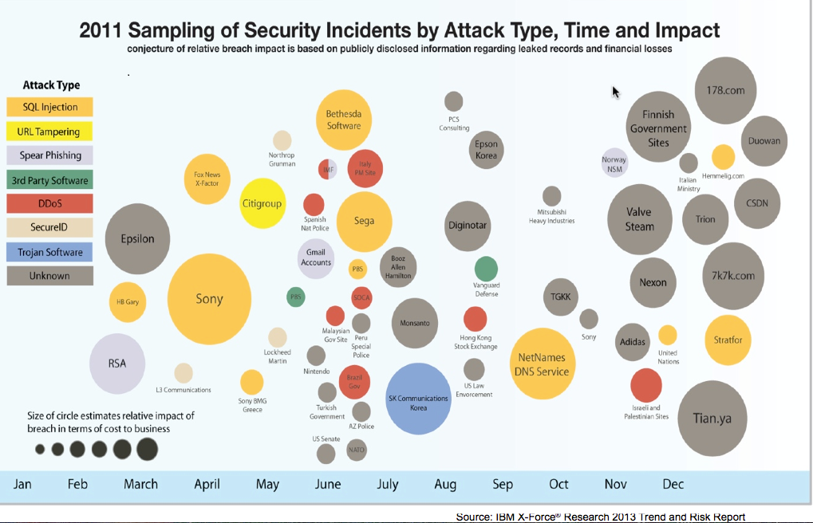

Slide 135
What this is about?
Overview
  Data in connected world - framework
    components (servers, routers, terminals/end-points, protocols, primitives)
    computing model (traditional client-server model, cloud computing)
    software architecture (OS, data base, web applications)
    data-in-transit, data-at-rest
  Actors – Employees, Customers, Suppliers/Contractors, Partners, and Cybercriminals
  Access – Identity/Credentials and Authentication Management
  Attacks (e.g. malware and phishing)
  Countermeasures (anti-malware, scanning and removal)
  What needs to be protected?
  How?
  How much does it cost?

Slide 136





Example: Attacks
Online /Mobile Banking
Phishing and Malware Fraud
Account Takeover, New Account Fraud
Mobile Fraud Risk
Customer
Criminal
Attack
Credentials, Data
WWW
Cross Channel Fraud
Attack
Employee
Advanced Threats (Employees)
From IBM Security Trusteer
Money, Intellectual Property, Business Data

Slide 137
Critical considerations
Events – security breaches/successful attacks
  Pre-event (security assessment, hardening, operations management)
    penetration testing and vulnerability assessment
    risk assessment and policy/procedures/standards compliance
    security architecture and intrusion detection
    audit
    training
  Post-event management - damage control, regulatory and legal aspects
    Digital forensic investigation
    Damage control
      notifying and remedying affected actors (customers, suppliers, partners)
      notifying and working with regulatory agencies
      legal
Insurance
  data, data, data
    What is knowable and what is unknowable?
    How to collect knowable data?
    Veracity of the data
  Quantifying risk? Exclusions? What should and should not be covered?
  Property vs. Personal Liability
Cost for the business entity (pre-event, post-event)
Cost for insurer

Slide 138

Cyber Security Today
Cyber Security Today
Presented by: Patricia Fisher, CEO & President JANUS Associates
Presented to: 2014 Symposium on Captive Insurance
September 17, 2014

Slide 139

Cyber Security Current State
US GAO – federal cyber crime up 680% since 2006
Community Health Systems
Target – 40m cards stolen; $200m spent to-date
Costs up 26% from a year ago
Notes:
Not Just Ethernet or IP
Give Examples of
SCADA - Utilities
RFID/Zigbee/802.11
MRI Example
Shopping Cart Example - RETAIL

Slide 140

Cyber Security Current State
Organizations’ cyber spending increasing
  Hardware
  Software applications
  Monitoring and management services
Without commensurate lowering of risk
Notes:
Millions of networks
Adding more IP Addresses to them
How many IP’s in home vs 5 years?

Slide 141

Why Problems Are Increasing
Lack of strategic approach
Weak processes
Third-party providers
Rapidly changing technologies
Overlooking insider threats
Lack of rigorous assessments
Notes:
Voice is connected to the IoT
Define Custom Nodes
Health sensors (in hospice and home)
Transportation, between cars
Home – microwaves, toasters
Office – Fire sensors, printers

Slide 142

Managing Cyber Security Risk
Strategic approach
Processes
Third-party providers
Regular assessments
Include all technologies
Assess Insider threats correctly
Notes:
Automation in factories
Automation in Hospitals
What about Privacy?
What about Security?
Power Consumption?
Need to modify spectrum assignments, Bandwidth

Slide 143

Incident Inevitability
Large amounts of data
People
Business partners
System failures
Notes:
The first Concern is privacy
Is knowing how you shop a privacy issue?
Is knowing where you are a privacy issue?
With So many devices collecting information about you, where is the line?
Day in the life example.
They know when you wake up and what your musical preferences are.

Slide 144

Common Misunderstanding
Mixing Compliance with Security
  Compliance is ensuring that we follow the rules
  Cyber security determines how the rules can be broken
Notes:
Describe the wearable technology trend
They know when you workout an what your health status is

Slide 145

Coupling Cyber Insurance and Security Risk Management
Prevention
  Cyber risk management to lower overall risk
    Develop strategic program
    Regular assessments
    Strong processes
    Extend this to partners
Recovery
  Lessening losses/problems results in improved ROI
    Methods of finding breaches
    Rapid response
    Training of staff
Notes:
Describe GPS and the apps that use it
Describe the storage of that data in the cloud
Describe the use of it in big data

Slide 146
Cyber, Privacy & Security Liability Insurance
CT Captive Insurance
9/17/2014
Presented By:
Charles P Bellingrath

Slide 147

Breaches: By Whom and Where?
Who has Unauthorized Access?
  Hackers
  Employees, Faculty and Students
  Outsourcers and Third Party Vendors
What are they accessing?
  Laptops
  Computer Networks/Wireless Networks
  PDAs/Cell Phones
  Paper Files
  Websites
  Clouds
  Fact: According to a recent RSA security survey, more than 89% of security incidents went unreported in 2007.
Picture Source: www.cyberinquirer.com

Slide 148
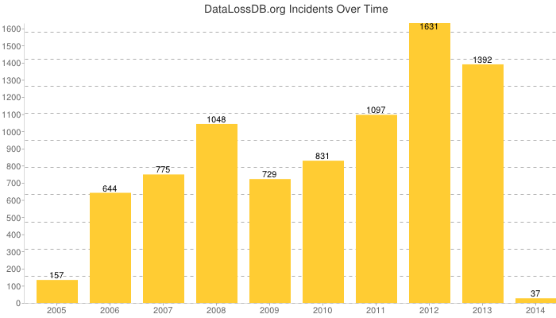
History of breaches over time
Source: www.datalossdb.org

Slide 149
Main causes of breaches- Type
Source: www.datalossdb.org

Slide 150
What is the Cost?
Data Breach incidents cost companies $201 per compromised customer record in 2013, compared to $188 in 2012.
Indirect Costs (Loss of Customers) accounted for $134 per record.
Direct Costs (such as forensics, notification costs, credit monitoring, etc.) account for $67 per record.
Average organizational cost of a breach in 2013 was $5.9M.
Negligent insiders and malicious attacks are the main causes of a data breach.
Malicious or criminal attacks account for than 44% of data breaches
Source – 2013 Ponemon Institute Research Report

Slide 151
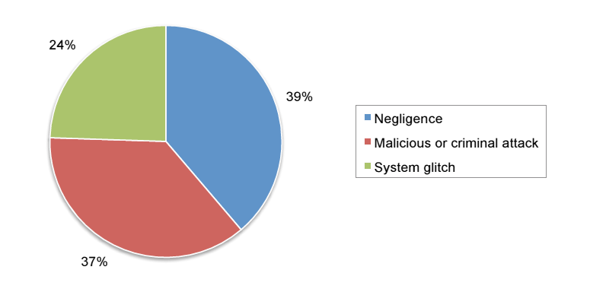
Primary Data Breach Causes
Source: Ponemon Institute: 2011 Annual Study

Slide 152
47 States now have Breach Notification Requirements:
Kentucky Joins as the 47th State on 4/23/2014
https://www.beazley.com/our_business/professional_liability/tmb/data_breach_map.html
Alabama, South Dakota & New Mexico are the remaining states that do not have any specific legislation pertaining to security breach notification.

Slide 153
Legal Landscape: New Regulations Lead to New Insurance Needs
Personal Data Privacy & Security Act of 2007
Health Insurance Portability and Accountability Act of 1996 (HIPAA)
The Gramm- Leach-Bliley Act of 1999 (GLBA)
Fair Credit Reporting Act
Fair & Accurate Credit Transactions Act of 2003
Electronic Communications Privacy Act of 1986
Family Educational Rights & Privacy Act (FERPA)
State Specific Security Breach Notification Laws*
High Tech Act (enacted with Jan 2009 Federal Stimulus Package)
MA GL, 201 CMR 17.00: Standards for The Protection of Personal Information of Residents of the Commonwealth of Massachusetts.

Slide 154
First Party Loss
Expenses to Notify Affected Parties
Business Income and Extra Expense
Extortion Payments
Crisis Management Expenses
Credit Monitoring Costs

Slide 155
Third Party Loss
Failure to Implement and Maintain Reasonable Security Measures
Negligence
Unfair, Deceptive and Unlawful Business Practices
Violation of Privacy
Invasion of the Customer’s Right to Privacy
Breach of Contract and Violation of Consumer Fraud Act
Defense and Damages
Media/Intellectual Property
Regulatory Actions including fines and penalties
  PCI Fines & Penalties

Slide 156
Current State of Cyber Risk Coverage in the Captive Market
Not widely adopted, yet
  Only 1% of captive owners underwrite cyber risk in their captive*
Yet, in another study, 83% of captive directors believe that cyber risk is a significant threat to companies**
Primarily used by companies with the greatest exposure:
  Health care companies
  Credit card data
*AON Risk Consulting- 2014 Benchmarking Study
**AON- 2014 Underrated Threats Report

Slide 157
But, clearly there are benefits…
Captives can:
  Offer limits the traditional market has trouble matching
  Ability to customize coverage
    Broader than available in the traditional market
    Occurrence vs. claims-made
Access to reinsurance market
Since it is a low frequency risk, opportunity to build up reserves
Encourages a more disciplined approach to identifying and handling risk

Slide 158
Given the potential benefits…
Why the disconnect between opportunity and reality?
  New, emerging threat
  The challenge of estimating cyber risk exposure
  Difficulty in understanding the consequences of an event
  Low frequency, high severity- Not your typical captive exposure

Slide 159
Need a three step, comprehensive approach
Pre-underwriting security analysis;
  -Identify points of exposure
  -‘plug the holes’
Tailored captive program; and
Post-event mitigation plan.

Slide 160
The Risk Retention Decision: Using Analytics to Optimize Your Captive’s Performance
Moderator:
John M. Lochner
Director, Consulting Services,
Towers Watson
john.lochner@towerswatson.com
Speakers:
Steve DiCenso
Principal & Consulting Actuary,
Milliman
Stephen.dicenso@milliman.com
Matthew Byrne
Director of Finance,
Archdiocese of Hartford
mab@aohct.org

Slide 161
Agenda
    Setting the Stage ⎯ An Overview of Risk Retention Decision-Making
    Actuarial Framework
      Total Cost of Risk (“Traditional”) Approach
      Cost of Capital Approach
    A Practitioner’s Perspective

Slide 162
Setting the Stage – An Overview of Risk Retention Decision-Making

Slide 163
Retention Setting Influencing Factors
    Cost/benefit analysis
    Insurance market conditions
    Risk appetite/posture (of the organization; of key decision-makers)
    Willingness to accept volatility in results
    Time horizon
    Art vs. science balance

Slide 164
Key Variables in Retention Setting Cost/Benefit Analysis
    Projected retained losses
    Premium/risk transfer pricing
    Time value of money
    Funding/capital considerations

Slide 165
Two Common (Possibly Opposing) Perspectives
    Income statement perspective
      (Re)insurance as an expense
    Balance sheet perspective
      (Re)insurance as contingent capital

Slide 166
Income Statement Perspective
    (Re)insurance is an expense
    Cost/benefit analysis often relies on a single assumption
    Decision based on current year arbitrage
    Focus on cost of risk
    Short horizon (one year)

Slide 167
Balance Sheet Perspective
    (Re)insurance is contingent capital
    Cost/benefit analysis includes range of assumptions/outcomes
    Decision based on most-effective long-term cost and use of capital
    Includes cost of capital
    Longer horizon (multi-year)

Slide 168
Captive Insurer Considerations
    Captives bring an additional layer of considerations atop those of the parent in setting corporate retention levels
    Be aware of (higher) retention’s impact on captive’s key financial ratios
      Reserves-to-capital/surplus
      Premiums-to-capital/surplus
      Per occurrence retention-to-capital/surplus
    Other parties have a vested interested in (and, therefore, a view on) the captive’s financial position
      Domicile regulator
      Fronting insurer
      Reinsurer(s)

Slide 169
Captive Insurer Considerations (cont.)
    Chosen retention level could have financial implications for the captive. Could affect required:
      Collateral (to secure fronting relationship)
      Capital/surplus level to maintain

Slide 170
Actuarial Framework

Slide 171
Retention Analysis ⎯ Two Views to Discuss
    “Traditional” Approach
    Cost of Capital Approach

Slide 172
“Traditional” Approach
    Evaluate expected cost of risk at retained limit
      Estimate loss cost per exposure unit based on historical losses or industry experience
      Account for operating expenses
    Evaluate cost of excess insurance (i.e., above retained limit)
      Quotes from commercial insurance market
    Sum of retained losses and excess insurance is total cost of risk (TCOR)
    Run various proposed retentions and select scenario with lowest TCOR
      Without confidence levels
      With confidence levels

Slide 173
“Traditional” Approach ⎯ Without Confidence Levels
Conclusion: $1M retention looks like best buy

Slide 174
“Traditional” Approach ⎯ With Confidence Levels
Single Year View
39% chance that increasing retentions will result in
an increase in the cost of risk in any given year

Slide 175
Cost of Capital Approach
    Evaluate TCOR (similar to Traditional Approach) to calculate “savings” in moving to proposed retention(s)
    Evaluate Cost of Capital at proposed retention(s)
      Estimate capital required (“at risk”) at retained limit to fund adverse loss scenario, where capital at risk = selected percentile loss amount minus expected loss
        We assume risk appetite is 90th percentile loss
      Estimate Cost of Capital required to fund adverse loss scenario
        We assume the internal cost of capital (“Hurdle Rate”) is 15%.
    Sum of TCOR and Cost of Capital is total cost of risk and capital (TCORAC)
    Run various proposed retentions and select scenario with lowest TCORAC

Slide 176
Cost of Capital Approach - Example
Conclusion: $1M retention looks better than $0.3M, but is it optimal?

Slide 177
Cost of Capital Approach – Compare all Options
Conclusion: It’s close, but $0.7M retention has lowest cost at 90th percentile.

Slide 178
Cost of Capital Approach – Example (cont.)
So it’s a bit easier to see:

Slide 179
Cost of Capital Approach – Example (cont.)
Here’s what it boils down to from a financial standpoint:

Slide 180
Other Considerations
    Alternative adverse loss scenarios can be modeled
      Based on company risk tolerance
    Alternative Cost of Capital rates can be modeled as well
    Remember to incorporate the effect of the insurance market cycle
      Run the model frequently to adjust to commercial market excess costs
    This work falls under broader Theory of Risk Reduction, an evolving area of research
      These are two common methods, but others exist as well

Slide 181
A Practitioner’s Perspective

Slide 182
A Tale of Two Captives
    Cup Re
    Cathedral Indemnity Co.
    Single parent, but group-like
    Parent is Catholic Umbrella Pool (CUP)
    Formed 2010
    Reinsurance company
    Liability
    Looking at increasing percentage participation in various layers
    Single parent
    Parent is Archdiocese of Hartford
    Formed 2012
    Deductible reimbursement cover
    Property, WC
    Looking at increasing specific or aggregate limit

Slide 183
Common Elements of these Captives
Board decision making in the face of uncertainty
Pricing exercises
Role of capital
Volatility in results
Cost-benefit analysis

Slide 184
Responsibility and Accountability
For-profit and non-profit Board members have the
responsibility to govern the multiplicity of specific
goods, services or missions with finite capital
The CFO helps identify the risk profile of the
enterprise, advises on whether to retain, neutralize
or transfer risks
Risk profile includes Core and Non-core risks
evaluation
Allocate capital

Slide 185
CUP RE
Board Captive Formation Thought Process
Already managing and sharing risk on pooled basis
Legal issues of the pool’s multiplicity of state insurance
laws and compliance with State insurance commissions.
Desire to domicile the pool in a rigorous regulated environment
with a knowledgeable captive industry and regulator
Desire for the captive to assume all the underwriting, operating
financial and accounting functions while members retain all
authority and participation agreement remain in force.
Opportunity to establish additional lines of risk retention for our
members and reduce costs while allocating capital prudently.
Providing insurance capacity to our members in hard markets and
transferring risk in soft markets.
Access to reinsurers as a captive company.

Slide 186
CUP RE
Pricing Risk
    Minimum acceptable premium followed guidance of the actuary using high projection (~70% confidence level) plus a 10% full limit loss load factor.
    Calculated expected loss ratios using projected losses and expected premium against an acceptable ranges per layer (i.e., not to exceed 80% except in loss rated layer.

Slide 187
CUP Re
Role of Capital in Risk Retention
  Various %s of assumed risk levels
    from 75% of $3.5mm x $1.5mm; 40% of $5mm x$5mm; 30% of $10.5mm x $10.5mm.
  CUP Re Capital level below hard minimum of 2x of largest potential single loss for > 6 months requires BOT action.
  CUP Re Capital level below the target minimum loss of
  1.33 of largest potential single loss invites BOT action
  but prohibits increasing risk retention.
  Capital at CUP is defined as the aggregate of all
  members’ equity plus IBNR.

Slide 188
CIC
Board Thought Process
Already assuming a retained risk on a pay as you go
basis.
Our WC balance sheet reserve account was based on
case reserves established by the TPA.
Coordination issues with the Claims TPA: No specific
party responsible. “Seat of the pants” not a good
execution strategy.
Provide low, stable long term cost for an insurance-like
program with improved risk management.
Contain the long term cost of risk, assuring availability of
funds to pay losses and build capacity to broaden risk
financing in leveraging capital and reinsurance markets.

Slide 189
CIC
Pricing Risk
    Alternative WC retentions were actuarially modeled using confidence level analyses
    Retention levels were set based upon prospective projected ultimate losses with a per occurrence limit of $500k.
      Using confidence levels from 10%-90%, we determined that a 70% confidence level was appropriate for prospective losses.
    Variability a factor in trending analysis
    Frequency and severity appear to be recently trending higher.

Slide 190
CIC
Role of Capital in Risk Retention
Sufficient capital was available from Archdiocese insurance fund
  Capital set at just over 1:1 premium to surplus ratio for prospective risks
We did not transfer prior WC claim losses until 12/31/13; LPT required $1.8M in capital
    Had this additional prior data to assess captive retention and capital levels

Slide 191
Role of Capital - Financial Risk Management
  Investment risk - asset allocation and portfolio performance
    Liquidity
    Yield
    Asset classes

Slide 192
Overall - Risks and Rewards
Summarize the risks of the ultimate loss as actuarially
calculated.
Match the risk profile to your confidence level of the High
and Low probabilities of loss and expected values.
Select the confidence level most appropriate to the risk
assumed.
Always value a project, service or firm on its net present
value of cash flows as capital decisions affect both short
term and long term cash flows.
Retain Capital and Surplus through Captive formation
Pay yourself.

Slide 193

Questions

