Slide 1
The Small Business Captive Revolution
October 26, 2017
MICHAEL SERRICCHIO, JD
MANAGING DIRECTOR
Marsh Captive Solutions
GLENN SASLOW
AUDIT PARTNER
Crowe Horwath
DAWNE DAVENPORT , ACAS, MAAA
SENIOR VICE PRESIDENT
Marsh Captive Solutions
CINDY LYFORD
VICE PRESIDENT
USA Risk Group, Inc.

Slide 2
SMALL CAPTIVES BY THE NUMBERS

Slide 3
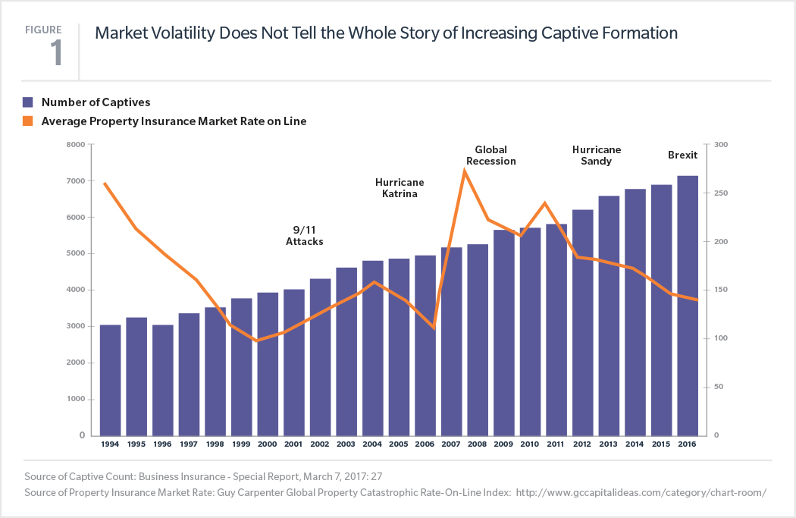
Continued Growth of Captives Worldwide
Small 831(b) Captive Emerge!

Slide 4
Small Insurance Company
831(b) Election – How it Works
Small Captive Insurance Company
Owner(s)
Premium
Premium
Insured(s)
Claim payments
Claim payments
Dividends
Dividends
Reinsurance (Optional)
Legend
Possibly
Definitely
Premium(s) deductible.
Premium income accumulated tax free.
Investment income taxed as ordinary income.
Dividends taxed capital gains rate.
Claim payments are tax neutral.

Slide 5
Benchmarking 2016
831(b) - Small Captives
Marsh-Managed Small Captives Making the 831(b) Tax Elections
A significant number of small captives rely on unrelated risk (25%) in the form of a well-developed and prudent risk pool.
This is because so many middle market and small organizations are structured as Limited Liability Companies (LLCs) or Subchapter S corporations, which necessitate a strong and stable risk pool to meet tax requirements.
Approach to Achieve Insurance Tax Status for All Small Captives

Slide 6
Small Captives
Similarities to Large Captives
At a very high level, small captives are just like large captives...
Fund retained corporate risk.
Means to access reinsurance markets for capacity.
Profit center (underwriting risk of third parties).
Must satisfy risk transfer and risk distribution.
...only smaller and with a special tax election.

Slide 7
Captive Creation
Identifying Candidates
What does a small captive candidate look like?
  Substantial high-severity/low frequency risks that are uninsured or self-insured.
  US taxpayers.
  Privately held or closely held (doesn’t have to be).
  Revenue: $200 million or greater (varies based upon industry).
  Cash flow positive.
  Willingness to post necessary capital (minimums typically $250,000, plus $1M+ based on business plan).
  Willingness to assume some risk and sometimes the risk of others (if a risk pool is needed).

Slide 8
US Domestic Captive Domiciles
As of 2016
CT = 14 CAPTIVES AND GROWING
Captive Domicile, Number of Captives
Alabama | 40
Arizona | 114
Arkansas | 2
Colorado | 3
Connecticut | 7
Delaware | 333
District of Columbia | 191
Florida | 0
Georgia | 9
Hawaii | 194
Illinois | 1
Kansas | 1
Kentucky | 122
Louisiana | 0
Maine | 3
Michigan | 15
Missouri | 47
Montana | 177
Nebraska | 4
Nevada | 160
New Jersey | 17
New York | 63
North Carolina | 52
Oklahoma | 47
Ohio | 0
Oregon | 0
Rhode Island | 0
South Carolina | 158
South Dakota | 14
Tennessee | 72
Texas | 12
USVI | 8
Utah | 422
Vermont | 587
Virginia | 0
West Virginia | 1
WA
MT
ND
NH
MN
ME
OR
ID
SD
WI
VT
WY
IA
MI
NY
MA
NE
IL
IN
OH
PA
RI
NV
UT
CO
KS
MO
WV
NJ
CT
CA
VA
KY
DE
OK
TN
NC
MD
AZ
NM
AR
SC
MS
AL
GA
DC
TX
LA
FL
AK
HI
Captive statutes
No specific captive statutes
Source: Business Insurance Directory - Captive Managers and Domiciles,
“Counting Captives,” March 2015: 3.

Slide 9
CAPTIVE MANAGER’S PERSPECTIVE

Slide 10
Captive Manager’s Perspective
Do we expect less interest in captive formations with an 831(b) tax election?
structure
purpose
structure
purpose
further review
8886 filing
further examination
8886 filing

Slide 11
Given the new rules, should a captive manager advise against the formation/ operation of captives taking the §831(b) tax election?
What is the captives purpose?
What coverages will the captive write?
Is there risk distribution?

Slide 12
What Captives Need to Do
Policies and Premium
Underwriting Procedures
Policy Issuance
Claims Handling
Claim Procedures
Claim Payments
Use of Assets
Parent or affiliates
Insureds
# 1 Question to ask – Is the captive operating at an arms length, as an insurance company would?

Slide 13
THE ACTUARY’S ROLE

Slide 14


1) Feasibility & Implementation
Does the parent entity have a risk profile suitable for a small captive?
  Limits/deductible/reinsurance
  Exposure basis
  Loss experience
What do we file with the domicile to set up the prospective small captive?
  Five-year expected cash flows
  Expected/adverse cases
  Risk transfer discussion

Slide 15



2) Ongoing Actuarial Services
Reserving
Renewal premiums
Changing policy terms or limits
Introduction of new coverages

Slide 16
AUDIT AND TAX MATTERS

Slide 17
REAL LIFE CASE STUDIES

Slide 18
1) Construction Client (Privately Held)
$500 million in sales.
Large commercial market premium spend.
Recommended coverages:
  Supply chain/contingent business interruption.
  Rip and tear.
  Professional liability.
  Equipment property coverage.
  Subcontractor default.
Benefits:
  Cover current exclusions/hard to place insurance (rip and tear).
  Tax efficient funding of risks.
  Wealth transfer by using trusts.
Challenges:
  Posting capital.
    Pledging assets.
Potential economic impact:
  $350,000 annually.

Slide 19
2) Beverage Distributor (Privately Held)
$145 million in sales.
Recommended coverages:
  Accidental contamination.
  Supply chain/contingent business interruption.
  Workers’ compensation and general liability buy down.
  Terrorism.
Benefits:
  Product not readily available in commercial market.
  Funding retained deductibles.
  Tax efficiencies (savings) with additional coverage's written.
Challenges:
  No material challenges.
Potential economic impact:
  $400,000 annually.

Slide 20
QUESTIONS AND ANSWERS

Slide 21

Marsh is one of the Marsh & McLennan Companies, together with Guy Carpenter, Mercer, and Oliver Wyman.
This document and any recommendations, analysis, or advice provided by Marsh (collectively, the “Marsh Analysis” are not intended to be taken as advice regarding any individual situation and should not be relied upon as such. The information contained herein is based on sources we believe reliable, but we make no representation or warranty as to its accuracy. Marsh shall have no obligation to update the Marsh Analysis and shall have no liability to you or any other party arising out of this publication or any matter contained herein. Any statements concerning actuarial, tax, accounting, or legal matters are based solely on our experience as insurance brokers and risk consultants and are not to be relied upon as actuarial, tax, accounting, or legal advice, for which you should consult your own professional advisors. Any modeling, analytics, or projections are subject to inherent uncertainty, and the Marsh Analysis could be materially affected if any underlying assumptions, conditions, information, or factors are inaccurate or incomplete or should change. Marsh makes no representation or warranty concerning the application of policy wording or the financial condition or solvency of insurers or reinsurers. Marsh makes no assurances regarding the availability, cost, or terms of insurance coverage. Although Marsh may provide advice and recommendations, all decisions regarding the amount, type or terms of coverage are the ultimate responsibility of the insurance purchaser, who must decide on the specific coverage that is appropriate to its particular circumstances and financial position.
Copyright © 2017 Marsh LLC. All rights reserved. MA15-13317

