Slide 1
Captives 101
What is Captive Insurance? How do I know if its right for my business?
CT Captive Symposium, October 25, 2017
Rocco Mancini, Marsh Captive Solutions
Alicia Miller, Crowe Horwath
Colin Finch Milliman
Janet Grace, CT Insurance Dept., Moderator
Notes:
Tom H kicks off panel

Slide 2
What is a Captive?
A captive insurance company is a bona fide licensed insurance or reinsurance company owned by a non-insurance company that either exclusively or primarily insures the risks of its owner(s).
  A captive may insure or reinsure the risks of its parent, affiliated companies, or chosen unrelated parties
  A captive is regulated under special captive legislation by domicile regulators only
    Not regulated by other state insurance departments
  A captive is a non-admitted insurer
    Not permitted to direct write lines requiring local licenses (i.e. – WC & AL)
    Buy downs of primary casualty deductibles are permitted

Slide 3
How Does a Captive Operate?
As a formal risk financing vehicle, a captive is characterized by the following operations:
  A captive must be licensed by regulatory authorities in the jurisdiction in which it is domiciled
  A captive must operate under the same legal constraints that govern any other (similarly classified) captive insurer domiciled in the same jurisdiction
  The insureds of a captive have direct involvement and influence over the company's major operations, including underwriting, claims management policy and investment
  Captives are typically governed by a Board of Directors and are often required to hold annual board meetings in the jurisdiction of domicile

Slide 4
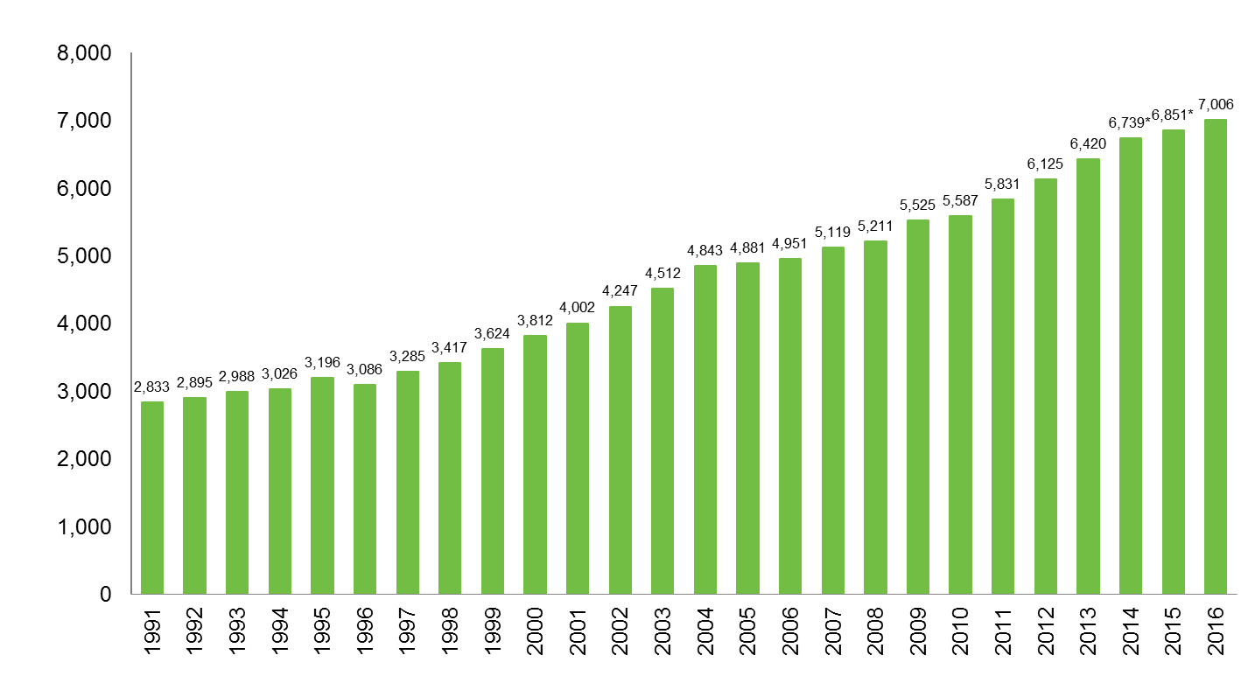
Number of Captives Worldwide
Source: Business Insurance: Special Report – 2017 Captives Report, "Total Captives Worldwide,” March 2017: 27. *2014 and 2015 are restated. (1994 to present), Source: Insurance Information Institute (1991-1993)

Slide 5
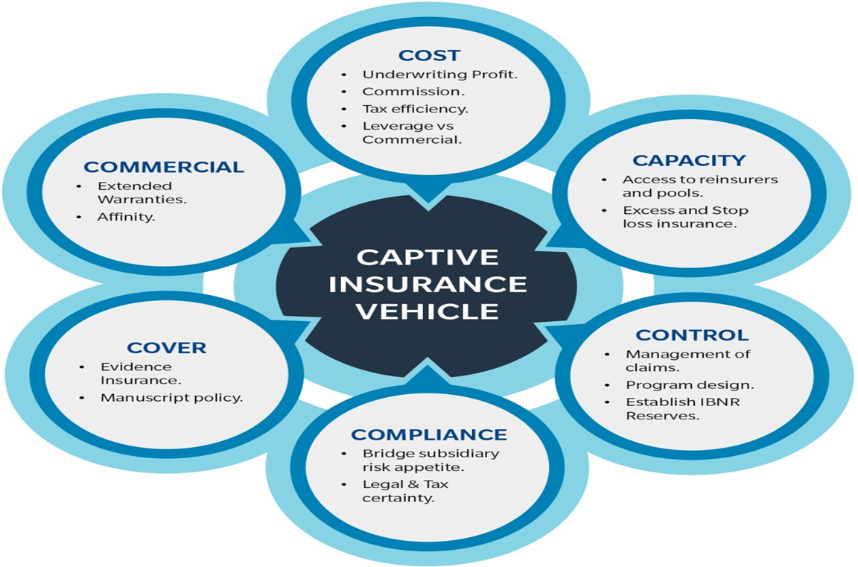
Why Do Companies Form Captives?

Slide 6
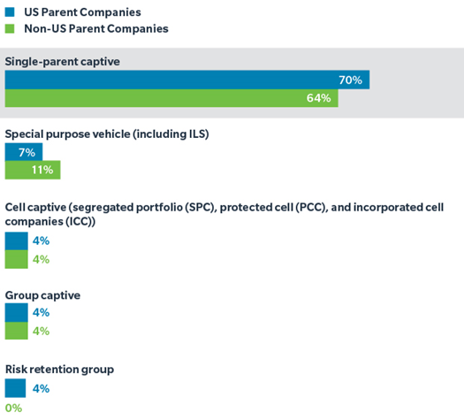
Captive Structures
Representing 70% of the total US captive count and 64% of the non-US captive count, single parent captives continue to be the preferred structure of captive owners
Special purpose vehicles (SPVs) accounted for 7% of the US benchmarked captives and 11% of the non-US benchmarked captives
  SPVs include life, XXX, ILS/SPI, etc.
  Marsh continues to see growth in its overall portfolio of SPV companies
  SPVs increased from 108 in 2014 to more than 112 in 2015

Slide 7







Policy Structures
Fronted Reinsurance Captive
Direct Issue Captive
Fronting insurer issues policies and arranges claims handling service
Captive insurer issues policies and arranges claims handling service and retains risk at agreed level
Owner / Insured
Owner / Insured
Admitted
Fronting Insurer
Reinsurance cessions to captive; captive retains risk at agreed level
Captive
Captive
Captive reinsures in excess of its desired retention
Captive retrocedes risk in excess of its desired retention
Reinsurer
Reinsurer

Slide 8
Policy Structures: Fronted Reinsurance
Reinsure when…
  Admitted insurance policies are required
  Need to meet proof of financial responsibility requirements (property -landlords, products liability -retailers)
  Security issues (A.M. Best rating)
  Providing insurance to unrelated parties

Slide 9
Policy Structures: Direct Write
Direct write when…
  Insurance policies required
  Admitted coverage not required
  Need formalized funding vehicle to allocate and track insurance expenses

Slide 10
Steps in Setting up a Captive
Feasibility Study
Documents business plan and captive operations. Should have actuary and tax counsel
Select Captive Manager
“Quarterback” to daily operations
File Application with Selected Domicile
Domicile selection dependent on many factors
Incorporate and Select Directors
Usually represents captive manager and Parent representatives
Select Bank & Capitalize Company
Consider requirements and capital vehicles
Begin Underwriting
Select Other Service Providers
Attorney, CPA, etc.
Captive is operational

Slide 11
Why Do a (Feasibility) Study?

Slide 12
Feasibility Studies
Strategic fit for the business:
  Input from Key executives/staff
  Understand operations, risks, & the insurance program
  Discuss business strategies and goals, among other things
  Involve tax and legal professionals; discussed corporate structures and the tax status today as well as implications of any planned strategic changes
  Consider level of control:
    Form own captive
    Instead, seek to join an existing group captive
    or joining a segregated cell captive owned by a third party, if so whom?

Slide 13
Captives: Roles of the Actuary
Retention Analysis
Feasibility Analysis
Annual Reserving (incl. Statement of Actuarial Opinion (“SAO”))
Annual Funding
Other Supporting Services

Slide 14
Roles of the Actuary – Retention Analysis
Analysis in determine an organization’s best use of it’s capital when deciding to retain or transfer risk
Determination of optimal retention by evaluating:
  Expected losses
  Probability distributions
  Risk appetite
  Reinsurance/excess insurance industry quotes
  Total Cost of Risk and Capital
Typical data required includes:
  Basic operational information – historical deductibles/retentions, operational changes, etc.
  Historical annual loss summaries (minimum 5 years) – includes accident/report date, paid loss and ALAE, case reserves, by claim
  Exposure information (historical and prospective
  Reinsurance (excess insurance) quotes at limits to be considered
  Company selected loss confidence level

Slide 15
Roles of the Actuary – Feasibility Study
Evaluation of the financial viability of the captive
  Includes:
    Forecast of loss estimates under certain/various policy limits and/or net retentions
    Five-year pro-forma financials to illustrate the financial results of the captive under both expected and adverse scenarios
      Additional data required includes premium growth assumptions, premium earnings/collection, expense assumptions, and expected rate of return on investments
Also aides in
  Risk identification/quantification
  Regulator requirements
  Reinsurance negotiations

Slide 16
Roles of the Actuary – Feasibility Study (cont.)
Loss Analysis
  Review of past loss experience
  Actuarial adjustments
    Development, Internal Factors (e.g. loss control), External Factors (e.g. trend)
  Selected loss rate
  Projected losses = Selected Loss Rate x Projected Exposures
    Projections at higher (lower) limits based on company data and/or industry factors
Pro Forma Financial statements
  5 years of prospective financial statements including income statement, balance sheet, and cash flow
    Use actuarially determined payout patterns
    Expected incorporation of ongoing expenses
    Investment modeling
    Surplus and capital contributions

Slide 17
Roles of the Actuary – Ongoing Operations
Reserving and SAO
  Annual certification of unpaid liability estimates by the appointed actuary
  Results help evaluate largest liability of the company
  SAO fulfills regulatory requirements
  Interim reserve studies if necessary
Prospective funding
  Estimate of loss and loss adjustment expenses for upcoming policy year
  Can be conducted during interim (i.e. 3rd quarter) reserve study or in conjunction with year-end
Other services
  Claims reviews
  Benchmarking
  Target surplus analysis
  Loss Portfolio Transfers

Slide 18
Sample Timeline For Actuarial Work
Retention Analysis
June - July
Feasibility Analysis
August - November
Captive Begins
Operations
November - December
Supporting Services
As Necessary
Annual Reserving (SAO)
January-March of following year

Slide 19
Captive Domicile - Onshore or Offshore?
A “substantial amount” (generally understood to mean not more than 5% to 10%) of third party business can't be written in a domestic captive
  If exceeded, a domestic captive loses its tax exemption (assuming it first qualified for such) and the captive’s income becomes fully taxable
Potential “drawbacks” to operating a captive offshore
  Need to avoid being deemed to be engaged in US trade or business
  Federal excise taxes if deemed “insurance”
  Withholding taxes on dividend or interest payments
If offshore, relatively low cost structure & a reasonable regulatory environment
Notes:
The discussion of domicile initially involves consideration of onshore (i.e., US state or territory) vs. offshore domiciles
There are dozens of domicile options
A feasibility analysis looks first at onshore vs. offshore alternatives and then digs deeper as best fits
Considerations
Regulatory oversight (responsible regulation & flexibility)
Capitalization
Permitted Coverages (TRIA, US benefits)
Receptivity to 3rd party risks
Domicile Costs
Federal Excise Taxes
Engaged in US trade or business ( penalties can apply)
Withholding taxes (e.g. equity investmets offshore care be subject to high withholding taxes, same for loan backs e.g. 30%)

Slide 20
Evaluating Onshore Domiciles
The onshore discussion is less tax centric, although some jurisdictions have different premium and self procurement taxes
Focus is more on:
  Regulatory scheme
  Permitted coverages
  Domicile costs
  Capitalization
  Administrative burdens
CT fits the bill, as you’ll learn throughout the Collaborative

Slide 21
Illustration: Estimated administrative costs and start up costs
AN example captive approximately $126,375 in administrative operating costs in Year 1, one time start up costs are additional
$40,000 | Captive management
$50,000 | Actuarial
$10,000 | Legal
$15,000 | Audit
$ 375 | CT Domicile Fee (annual license)
$ 1,000 | Board meeting/travel expenses
Claims administration varies with the type and volume of transactions, most hire a TPA to assist on a fee for service basis
To evaluate and launch the captive a prospect will incur some one time costs estimated at ~$80,000 (scope dependent)
Notes:
Lets review the annual expense structure might expect (illustrative -- your actual results will vary!)
Start up costs
These costs include the professional fees for the feasibility study (~$75,000) and application/processing costs and fees (~$4,800) -- $800 application fee, 4,000 processing charges (billed by CTDOI as actual)

Slide 22
Capitalization
The captive will need to be capitalized to begin operations, with such capital and accumulated surplus amounts maintained to ensure that the captive has a sufficient financial foundation going forward
In CT, this capital can take the form of cash and/or letters of credit (LOC)
A single parent captive must have a minimum of $250,000 in capital/surplus per CT captive regulations, amounts for other captive types vary
The amount of capital really needed depends on the risk profile, the amount of which reflects various ratio tests (retention ratio, premium : surplus, reserves : surplus) and the nature of the coverage provided
Notes:
Given the projected losses and premiums there are certain ratios that regulators consider
The actual required capital/surplus could be higher because domicile regulators generally view capital/surplus adequacy in the following context, based on certain “rule of thumb” measures:
Amount needed to keep the captive’s net premiums-to-capital/surplus ratio less than 3-to-1;
Amount needed to keep the captive’s net reserves-to-capital/surplus ratio less than or equal to 3-to-1;
Amount potentially needed to ensure the captive has at least $X - $X of capital/surplus for every $X of per occurrence retention it assumes
Amount needed to cover losses in excess of “expected value.”

Slide 23
Captive Taxation

Slide 24
Types of Taxes
  Federal Income Taxes
  Federal Excise Taxes
  State Premium Taxes
  Self-Procurement Taxes
  State Income Taxes

Slide 25
Tax Benefits – Compared to Self-Insurance
Under a straight self-insured arrangement, an insured would recognize a tax deduction as losses are paid out over time.
For example, General Liability losses, which occurred within one underwriting period are paid out over a period of eight to ten years.
The tax deduction is recognized as losses are paid out.

Slide 26
Tax Benefits – Compared to Self-Insurance, cont.
Example:

Slide 27
Tax Benefits – Compared to Self-Insurance, cont.
Large Captives (or small not electing 831(b)):
More beneficial to be treated as insurance:
  Accelerated tax deductions (i.e. loss reserves)
  State tax benefits – Depends on each state’s definition
Single Parent Captives most significant:
  Taxes are significant reasons the captive was formed
  Insurance expense deduction would be denied at parent level
  State Income tax savings.

Slide 28
Premium Deductibility
  Brother-Sister Insurance
Parent
100%
100%
100%
100%
100%
100%
Insurance
Subsidiary
Operating
Subsidiary
Operating
Subsidiary
Operating
Subsidiary
Operating
Subsidiary
Operating
Subsidiary

Slide 29
Tax Benefits – Compared to Self-Insurance, cont.
  FACTS:
Premiums 1,000,000
Unearned Premiums (200,000)
Total Earned Premium 800,000
Change in unpaid
Loss Reserves (700,000)
GAA Expenses (200,000)
Net Income (100,000)
***FIRST YEAR OF OPERATIONS

Slide 30
Tax Benefits – Compared to Self-Insurance, cont.
Insurance Company
Book Income (100,000)
Adjustments:
Loss Res. Disc 70,000
UPR 40,000
Taxable Income 10,000

Slide 31
Tax Benefits – Compared to Self-Insurance, cont.
With and Without Comparison:

Slide 32
Federal Tax Elections
  831(b):
  Small Company Election to be taxed on investment income only
  Greater of direct written premium or net written premium cannot exceed $2.2 million
  501(c)(15):
  Extremely small insurance companies can apply to be taxed exempt
  Gross receipts cannot exceed $600,000 (aggregated for entire controlled group)
  Greater than 50% of gross receipts must be from premium

Slide 33
Quantifying Benefit of
831(b) Election
Premium Deduction (premiums paid to the captive) |  | 1,200,000
Tax Rate |  | 40% | *
Tax Benefit |  | $480,000
Cost to Run the Captive |  | ($75,000) | *
Tax Benefit After Fixed Costs |  | $405,000
Loss Costs not Deductible in Captive |  | ????????
Total Tax Benefit |  | $Net
* Estimates used for this example, every case will be different. This illustrates the point that the more losses and expenses there are with a small captive, the greater the benefit is diminished.

Slide 34
The History

Slide 35
The History of the War with the IRS, cont.
Common Law:
Helvering v. LeGierse– 1941 Supreme Court estate tax case which established ground works to what defines insurance.
  Insurable risk
  Risk shifted to insurer
  Pooled

Slide 36
The History of the War with the IRS, cont.
IRS Strikes
The Economic Family Theory:
Revenue Ruling 77-316 – An insurance arrangement between related corporations should be re-characterized as a “self-insurance” reserve within an “economic family”.

Slide 37
The History of the War with the IRS, cont.
Industry Fights Back
The Courts rule favorably:
Humana Inc. v. Commissioner
Gulf Oil Corp. v. Commissioner
AMERICO, Inc. v. Commissioner
The Harper Group v. Commissioner
Sears, Roebuck & Co. v. Commissioner
Hospital Corp. of America v. Commissioner

Slide 38
The History of the War with the IRS, cont.
IRS Concedes:
Revenue Ruling 2001-31 – The IRS will no longer invoke the economic family theory
However, they will continue to challenge certain captive insurance transactions based on facts and circumstances

Slide 39
The History of the War with the IRS, cont.
IRS Tries Again
The Courts rule favorably:
Rent A Center v. Commissioner
Securitas v. Commissioner
RVI v. Commissioner

Slide 40
What Constitutes Insurance?
  The IRS ‘definition’ of an insurance company
  For purposes of the preceding sentence, the term "insurance company" means any company more than half of the business of which during the taxable year is the issuing of insurance or annuity contracts or the reinsuring of risks underwritten by insurance companies
  The IRS does not define “insurance contract”! Therefore we must look to the courts for case law interpretations:
  Insurance contract must have:
    Risk Shifting
    Risk Distribution

Slide 41
Risk Shifting
In Helvering v. LeGierse, the Supreme Court said that for a transaction to be considered insurance, it must transfer the risk of loss from one party to another, among other points. That is Risk Shifting.
How risk shifting is defined by law, courts, and the IRS is the subject of much time and money. Captives have been at the center of this issue.
Have you shifted the risk? How much is needed to qualify (5, 10, 50 percent)? What about reinsurance? Who owns the captive?
Rev. Ruling 2002-89 states that 50% of unrelated business will suffice for Risk Shifting.
Rev. Ruling 2002-90 states 12 subs whereby no one sub makes up more than 15% of the premium or less than 5% of the premium will qualify.

Slide 42
Risk Distribution
  Common Approaches to achieving risk distribution:
    Unrelated Risk
    Pooling
    Employee Benefits Coverages??
    Adequate Brother-Sister Theory

Slide 43
Risk Distribution
  Risk Distribution relies on the Law of Large numbers:
  No one insured will pay for their own losses
  Rev. Rul. 2002-90 indicates 12 insureds are enough
  Rev. Rul. 2002-91 indicates 7 insureds enough for small group captives
  Rev Rul. 2005-40 was issued as guidance for Risk Distribution:
  One insured is not enough
  Two insureds may be enough (Probably won’t hold up)
  90% of premium from one insured is not enough
  SMLLC’s are parent risk
  FSA 200202002 states one insured making up between 86% to 88% of the premium is not enough risk distribution
  Homogeneity

Slide 44
Other Considerations
  Capitalization
  Business Purpose
  Indemnifications & Guarantees
  Commonly Accepted as Insurance

Slide 45
Not Qualifying?
Reasons for not wanting to be taxed as an insurance company:
  Tax Exempt Members
  REIT members
  Short tail property (not a big deal)
  Fully Reinsured

Slide 46
State Premium Taxes
Connecticut
  Taxes are on a sliding rate scale ( 0.0038 - 0.00024); the annual minimum tax is $7,500.00 and the annual maximum aggregate tax is $200,000
  A tax credit of $7,500 applies the fist year; for captives with <$20 million in premium net first year premium taxes taxes are $0.

Slide 47
Develop pro forma financial statements for the proposed captive program
The pro forma financial statements incorporate the previous noted assumptions pertaining to retained losses, program expenses, and capital requirements (or a margin for risk) to support the written exposure
Separately, as part of a business plan submitted with the captive application you also need to develop an Adverse Case pro forma to test the captive “under stress”
The stress is more likely and likely more severe if the adverse event occurs early in the captives life
  Should such losses be experienced early, the captive owners would likely need to contribute additional capital to the captive and/or increase premium funding prospectively

Slide 48
A captive could provide advantages going forward…
Greater entity presence
Greater flexibility to cover unique risk exposures
Direct access to reinsurers
Presumable cost savings
Some disadvantages potentially exist, as well…
A captive requires capital
A captive incurs additional expenses for captive management, audit, legal and domicile fees
A captive is a regulated insurance company
A captive typically requires management time (Board meetings, underwriting, risk control, and claims committees)
Notes:
Entity presence gives attention to risk and claims
Flexibility to cover unique exposures lets the entity define what is a covered claim (e.g. good will/reputation vs. accident event/bad outcome - "what is a medical error?"). Who is insured?
Reinsurance access solution
Management time - well invested can be worth the avoided risk
Smooth the cyclicality of the insurance market
Reduce loss through improved claims management
Capture underwriting profits
Improve investment management of claim reserves
Increase tax savings opportunities (should be incidental)
Management decision will be driven by several factors:
What is the cost/benefit? <describe>
Does the Company have the staff and capital to support a captive?
Is management comfortable with the level of risk taking?

Slide 49
A Captive surrounds itself with qualified service providers & works with its parent/owner and the regulator in achieving its purposes
Parent or Policyholder
Captive
CT Ins. Dept.
Captive
Investment Manager
CPA
Attorney
Actuary
Broker
Captive Manager
Claims Handler

Slide 50
A captive makes sense, what next?
Hand-in-hand execution by the client team, and (once selected) the captive manager, consultant, captive counsel and accountants as necessary
Final decision regarding selection of the captive’s domicile
Affirmation of coverage lines to include
Commitment to funding capital & timing
Selecting captive service providers
Meeting with prospective domicile regulators
Procuring actual fronting services & developing rates by specialty
Procuring reinsurance protection (where required)
Developing the business plan or assembling required materials to seek domicile approval

Slide 51
Why Connecticut?
Favorable Captive Law
  Permits formation of all types of captives
  Application fees are significantly lower than many of the popular U.S. domiciles
  Better initial capital and surplus requirements
  Competitive annual tax rates
    Unique $7,500 credit against first year premium taxes
  Flexible annual reporting requirements
  Uniform examination schedule for all captives
  Exam costs are limited (in house vs outsourced oversight & examination)

Slide 52
CONNECTICUT: The Thinking Person’s Domicile
200+ year heritage as the “Insurance Capital” of the U.S.
Home to more service providers, fronting carriers and reinsurers dedicated to the captive industry than almost any other US domicile
Convenient location at the crossroads of the Northeast
State government has identified the captive marketplace as a huge growth opportunity for the state and is dedicating tremendous resources to develop Connecticut as a first class domicile
Ranks #1 in the U.S. in insurance jobs per capita
Ranks #1 in the U.S. in life premiums written
Ranks #2 in the U.S. for ALL premiums written

