Slide 1
CYBER LIABILITY IN CAPTIVES: THE EVOLVING PARTNERSHIP BETWEEN CAPTIVES AND THE COMMERICAL INSURANCE MARKET CCIA 2017
October 26, 2017

Slide 2
Michael Serricchio, Moderator Managing Director
Norwalk, CT

Slide 3
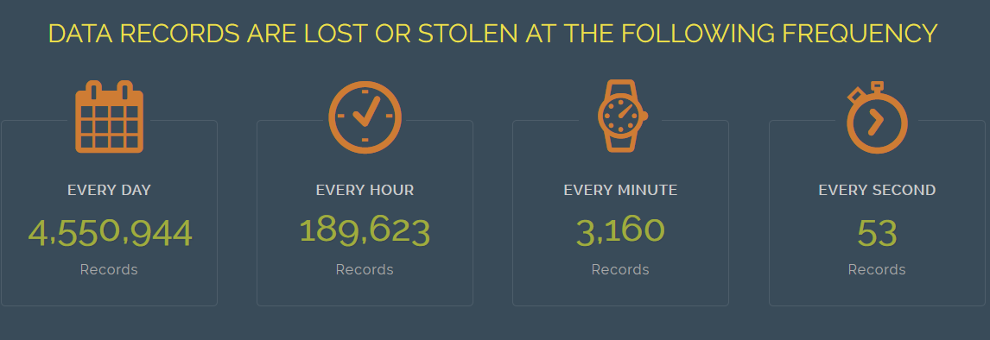
The Captive Landscape and Cyber Risk
Key Drivers:
Tailored coverage for exposure versus market appetite.
Access to reinsurance for catastrophe (CAT) limits.
Write coverage for emerging cyber risks –Cyber Terrorism under TRIPRA.
Consolidation of cyber programs across operating companies.
Top Industries Using Captives for Cyber Risk:
Communications, Media & Technology.
Financial Institutions.
Healthcare.
Retail/Wholesale, Food & Beverage.
Notes:
7 min (slides 5-7)
Mike to ID client to speak to Cyber – ideally the client would talk about how they evaluated the risk and then how they see the captive as adding value to their cyber program

Slide 4
Cyber Terrorism
US Treasury announced in December 2016 that cyber terrorism is included under TRIA.
This provides a powerful advantage to captive owners.
Current captive owners should consider TRIA and cyber terrorism.
Companies without a captive, in all industries, should strongly consider a captive for access to TRIA and other lines.
Notes:
Link the two subjects together and talk about Cyber/BI/Terrorism – Mike

Slide 5
Stephen Vina Senior Vice President
and Advisory Specialist
New York, NY

Slide 6
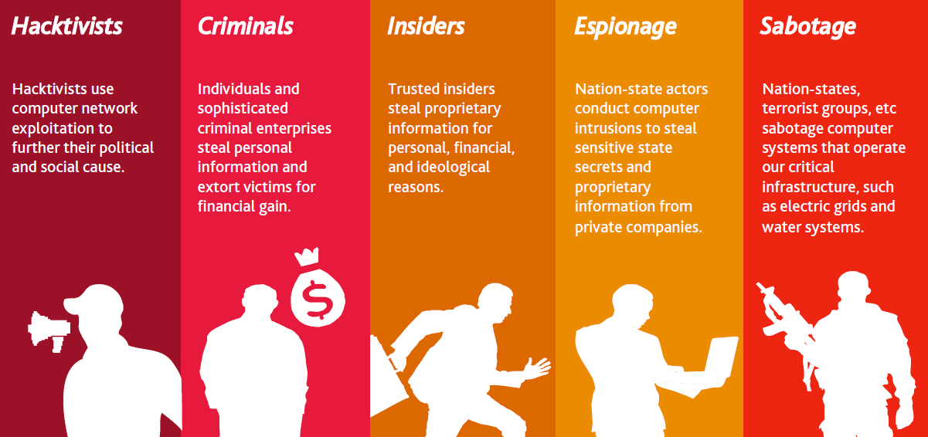
TYPES OF CYBER THREATS & ACTORS
System Failure
Generally includes any unintentional and unplanned outage of a computer system.

Slide 7
Categories of Data
Payment Card Information (PCI)
Personal Health Information (PHI)
Personally Identifiable Information (PII)
Valuable for credit card fraud.
Valuable to commit health insurance fraud.
Associated costs include regulatory fines (e.g. OCR investigations).
The catch-all for other sensitive information, ranging from SSNs to email addresses to bank account numbers to physical addresses.
Associated costs include card reissuance fees, PCI fines.
Business Data
Sensitive corporate data, including trade secrets, design plans, manufacturing plans, projections, forecasts, and M&A activity
Associated costs include data restoration and third party liability
Valuable for economic espionage and financial gain

Slide 8
What is the Impact Across an Organization?
Cyber Risk - Everyone Has a Stake
CEO
Board
Third Parties
Operations
Public Relations
Customers
CFO
Compliance
Legal
HR
IT
Risk Manager

Slide 9
INSURABLE CYBER RISKS What Policies Respond?
Cyber Coverage for Your Organization
Cyber
D&O
E&O
Fidelity & Crime
Property

Slide 10
First and Third Party Cyber Coverage
First Party
Data Restoration
Event Management / Breach Response
Cyber Extortion
Network Business Interruption
Network Security Liability
Media Liability
Privacy Regulatory Defense Costs
Third Party
Privacy Liability

Slide 11
MARKETPLACE
Bermuda:
10+ carriers
London:
20+ carriers
US:
30+ carriers,
MARKET CAPACITY CONTINUES TO EXPAND
Global capacity now exceeds US $1.6 billion.
The largest programs are now US $600 million and higher.
London and Bermuda markets are a key source of capacity.
Industry focus is on business interruption coverage.

Slide 12
Todd Cunningham, Zurich
Head of Strategic Risk Solutions, Zurich Commercial Insurance
New York, NY

Slide 13
Cyber is more like property than any E&O product
you can have all the right controls in place and still have a “fire”

Slide 14
Cyber in the News
Cyber risk is a growing global threat. While digitization is revolutionizing business models and transforming daily lives, it is also making the global economy more vulnerable to cyber-attacks. As a result, the economic and insurance consequences of cyber-crime are increasing. In 2016, cyber-attacks were estimated to cost businesses as much as $450 billion a year globally (Graham, 2017).
As the cyber threat grows so the demand for cyber insurance increases. Today, Lloyd’s Class of Business team estimates that global cyber market is worth between $3 billion and $3.5 billion (Stanley, 2017); by 2020, some analysts estimate it could be worth $7.5 billion (PwC, 2015). Property/casualty insurers wrote $1.35 billion in direct written premium for cyber insurance in 2016, a 35% jump from 2015, according to reports by Fitch Ratings and A.M. Best (A.M Best, 2016).

Slide 15
Current State
Most companies have a desire to protect themselves from cyber-related risks to their business
Market response has been through Security and Privacy E&O or “bolt on” cover to P&C contracts
Challenges with this approach include pricing, coverage and contract certainty
Challenges for Captives include volatility, scenario modeling and retrocessional cover.

Slide 16
Cyber Market
Among cyber insurers, the top 15 writers were responsible for around 83% of the market in 2016, with more than 130 total insurers writing cyber policies during the year (Insurance Journal, July 24, 2017)
Top writers of Cyber in the US (YE – 2015)
AIG – 22%
Chubb – 12%
XL Catlin – 11%
AXIS Capital – 8%
Beazley Insurance – 7%
Zurich – 7%

Slide 17
Emerging Coverage Issues in the market
Supply Chain disruption coverage
Administrative Errors
Consequential Reputational Harm coverage
Imbedded crime coverage for social engineering thefts
First party coverages outside the limits
Coverage for “bricked” equipment
Contingent property damage coverage
Unlimited reimbursement period for business income loss

Slide 18
Potential Captive Solutions
Monoline Retrocessional cover
Integrated Risk Reinsurance – with Cal Quake, Media/Cyber, Casualty, Management Lines, etc.
Capital Market Capacity – Cat Bonds, ILS, etc.
Bermuda Casualty Form
Tough coverages at a time of liability crisis (1986)
Coverage innovation (Integrated Occurrence) and expansion
Tight limits – single limit, ALAE included in limit
Minimum attachments beginning at 50 or 100 million, for disasters only
Profitable pricing for risk and capacity

