Slide 1
Session 8: Innovative Uses of Captives: Cyber and Beyond
Scott Sobel, Senior Consultant, Aon Risk Financing & Captive Consulting
Adam Peckman, Global Practice Leader – Risk Consulting, Cyber Solutions

Slide 2
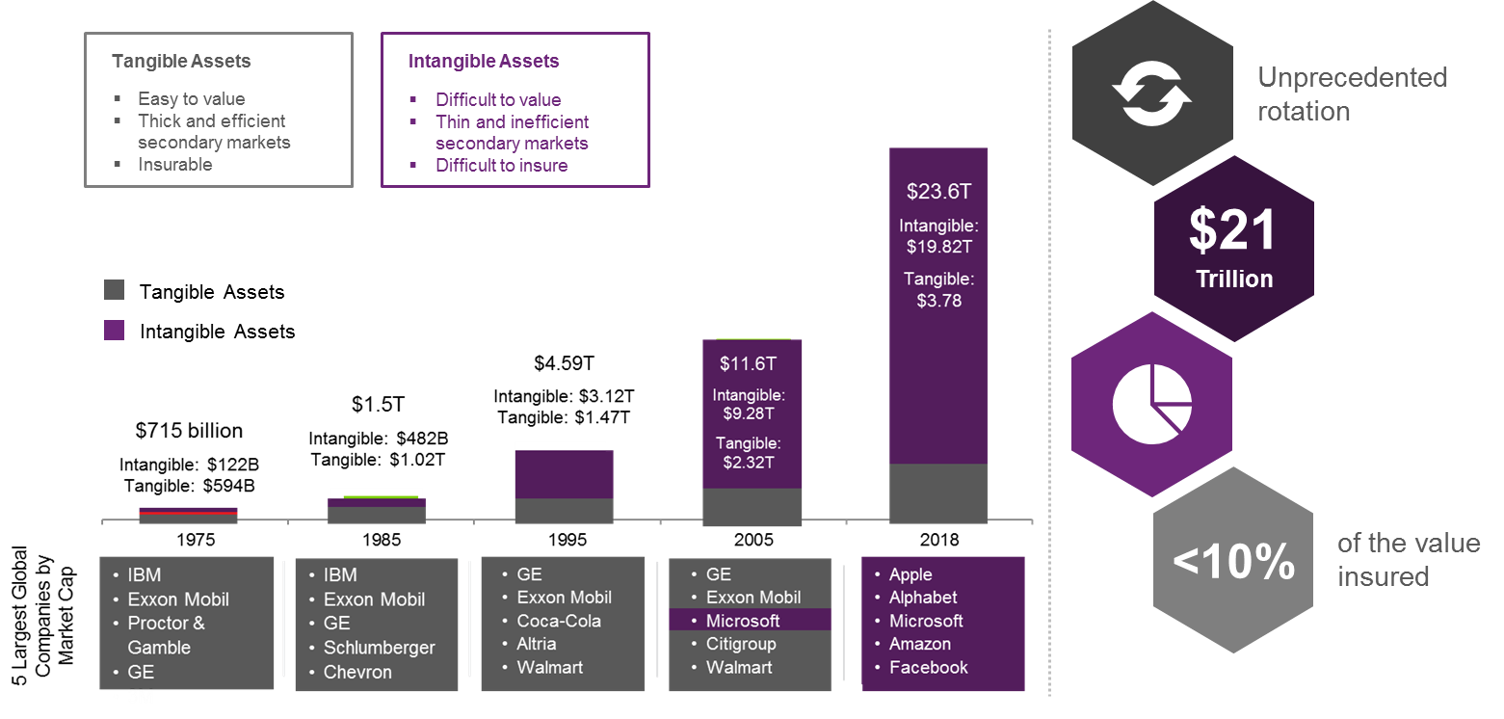
Rotation of tangible to intangible assets
Tangible Assets vs. Intangible Assets for S&P 500 Companies, 1975-2018

Slide 3
Dynamic complexity facing Insurance Strategies
Evolving challenges facing clients given changes to digital transformation, security threat environment, and regulatory landscape.
Data Protection Regulations
NY DFS March 1, 2019, deadline full force & effect
EU GDPR ($57M fine against Google)
California Privacy Act etc.
Mergers & Acquisitions
Due Diligence
Transactional Liability
Third Party Relationships
System dependencies
Embedded digital technology (IoT, IIoT, AI, ML, 5G, Distributed ledger/Blockchain, Internet of Things/connectivity, Robotics, Predictive analytics, Big data)
PCI and other industry compliance programmes
Critical Infrastructure / Black Swans
Increasing deployment of Cloud and Mobile computing
Future of cyber security technology, Crypto

Slide 4

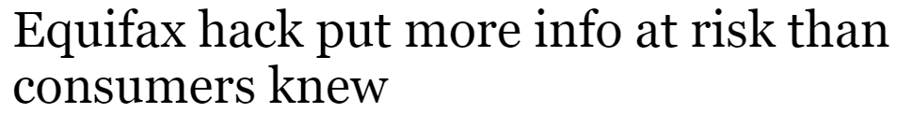

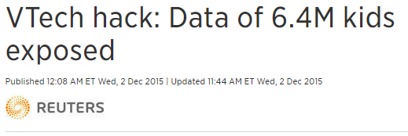
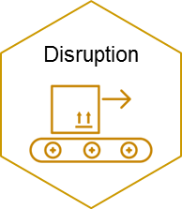
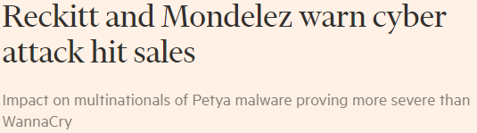
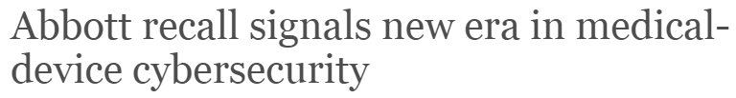

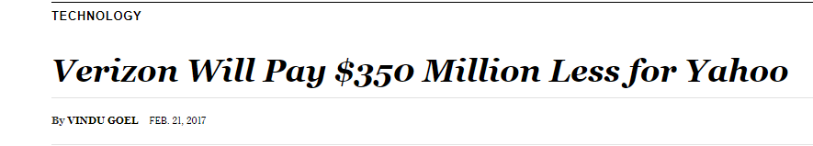



Cyber incidents triggered boarder ERM risks
Cyber risks are no longer limited to data breaches, as technological integration expands so to does the downstream cyber exposures

Slide 5
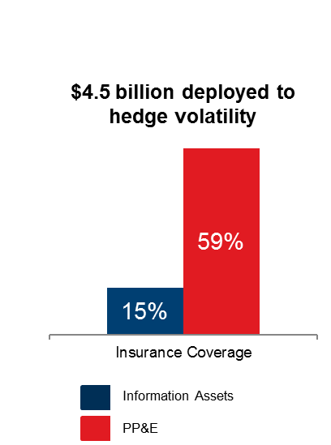
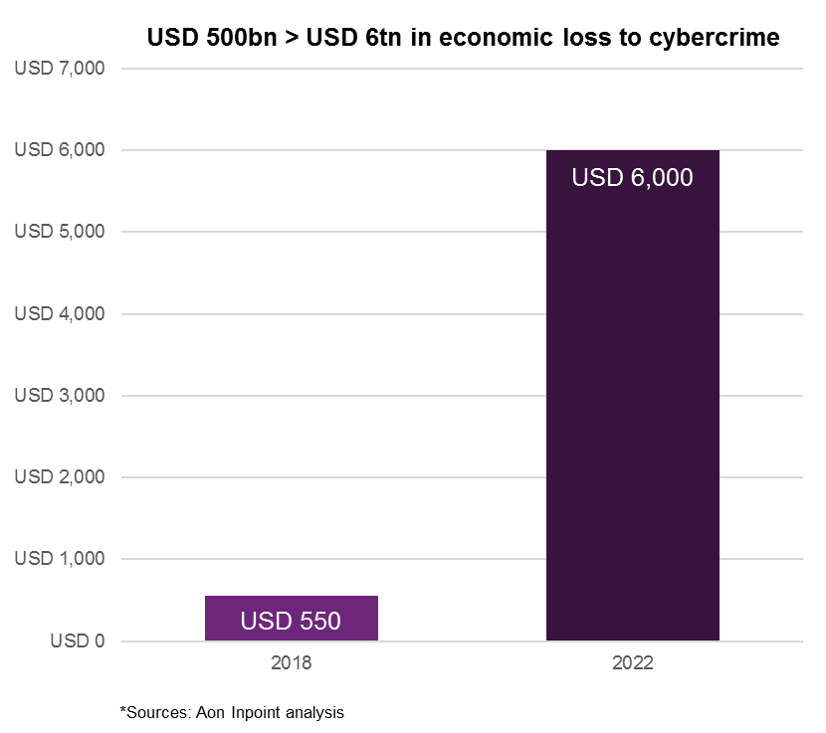
Capital Efficiency Gap Facing the Digital Economy
The Digital Economy is losing $550bn (USD) from cybercrime, growing to an estimated $2-$6 Trillion by 2021*, whilst the level of hedging against that loss lags
*Sources: 2017 Aon Sponsored Ponemon Institute Global Cyber Risk Transfer Study Information Asset vs. PP&E Risk Summary

Slide 6
An Evolving Captive Landscape
2019 survey of cyber risk – captive retention philosophy, strategies, and trends
Cyber Growth in Captive Market | +263% GWP
Leading industry (by GWP) | Healthcare Energy Financial Institutions Food & Beverage Life Sciences
Lagging industry by GWP | Aviation / Aerospace (0%) Financial Institutions (0%)
Range in Limits | + USD 100,000
Source: Aon Captive & Insurance Management client survey 2019

Slide 7
Coverage
Moving beyond more standard crisis management and liability coverages

Slide 8
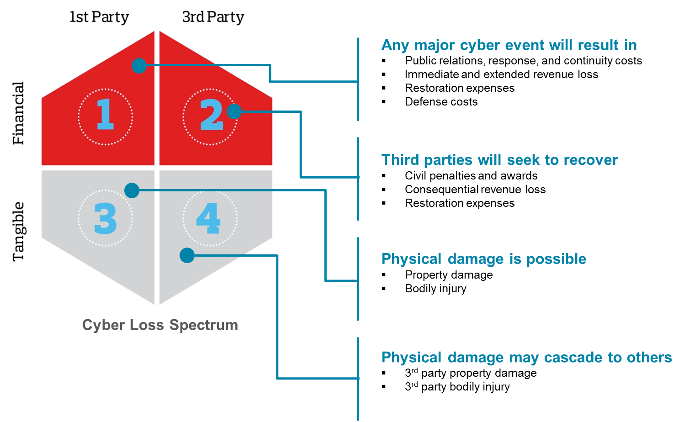
Coverage
Moving beyond more standard crisis management and liability coverages

Slide 9
Rationale for Captive Utilization
Broad array of rationale for captive participation

Slide 10
Captive Decision Making
Broker Guidance remains the premium determinant of choice for the vast majority of Aon managed captives
Financial Analysis | 7%
Qualitative risk assessments | 22%
Peer Market Benchmarking | 37%
Management Intuition | 41%
Broker Guidance | 67%

Slide 11
Unlocking Future Growth and Value
Broker Guidance remains the premium determinant of choice for the vast majority of Aon managed captives
Cyber Risk needs to be integrated in to the broader Risk Management Framework
CSOs / CISOs leverage the Captive as a strategic tool
Increased capacity available for innovative coverage components

Slide 12



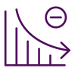
Risk Managers driving the strategy
Risk Managers need to take a more active role in facilitating the evaluation of Cyber Risk across functions and empowered by proven risk management techniques
Assess
Quantify
Captive
Assess Cyber Risk
Model Financial Impact
Design Risk Financing Strategy
Alignment on Cyber Risk across the business
Executive Leadership
CTO/CSO/CISO
General Counsel
Risk Officer

