Slide 1
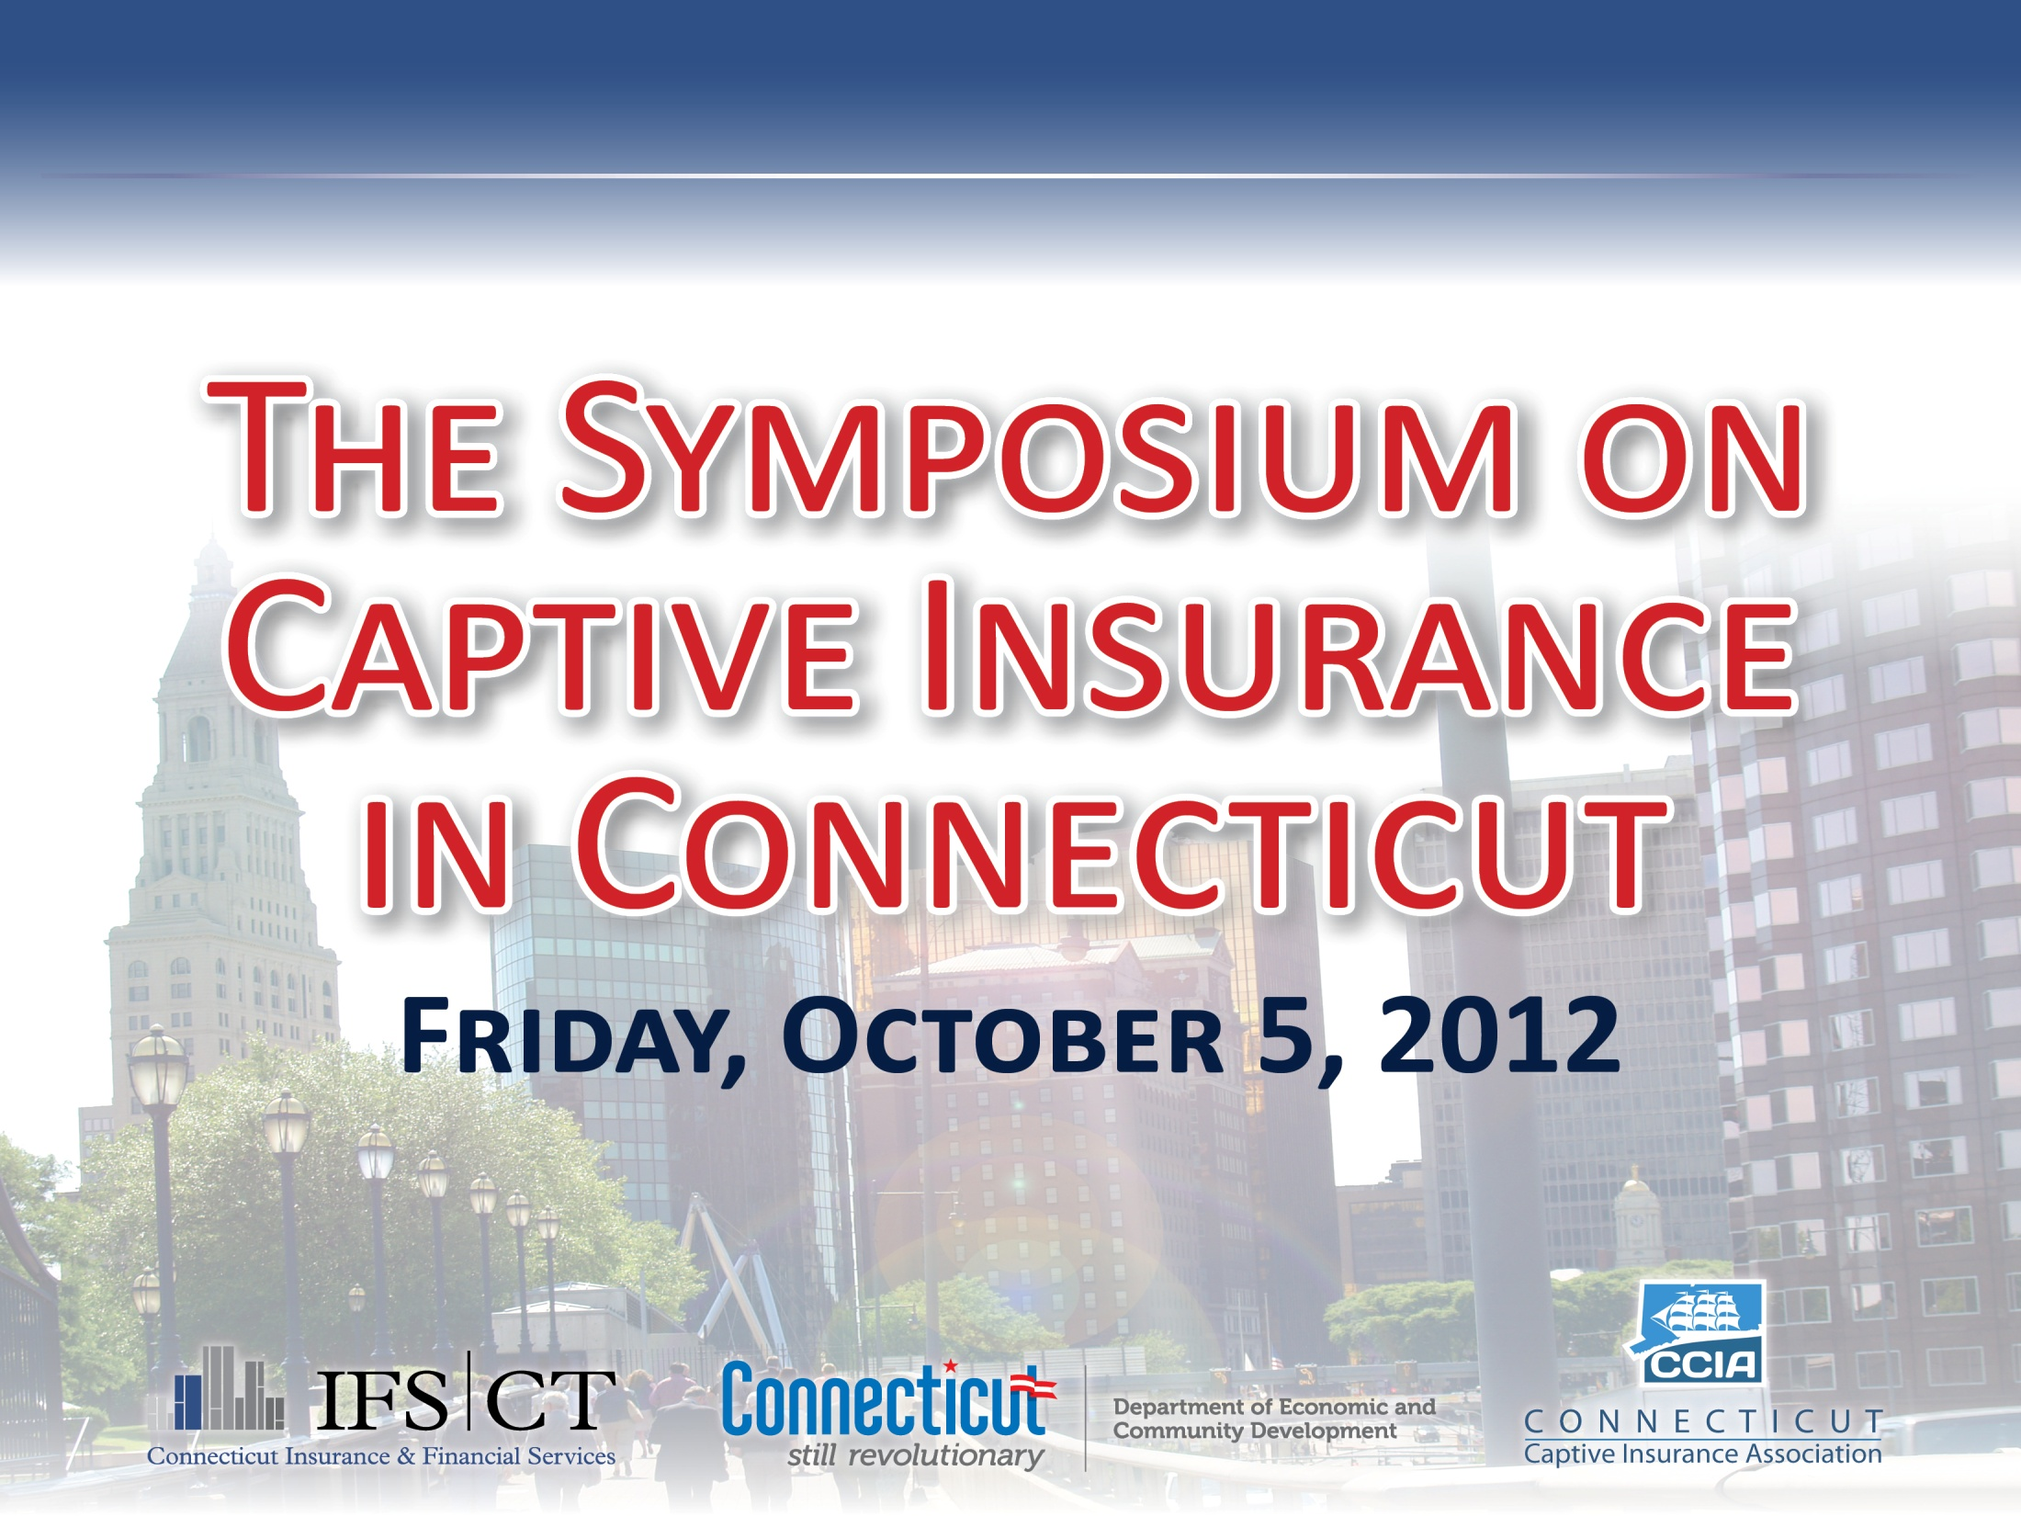

Slide 2

Thomas Hodson
Connecticut Captive Insurance Association
Susan Winkler
Connecticut Insurance & Financial Services

Slide 3
Commissioner
Thomas Leonardi
Connecticut Insurance Department

Slide 4
Commissioner
Catherine Smith
Connecticut Department of Economic & Community Development

Slide 6
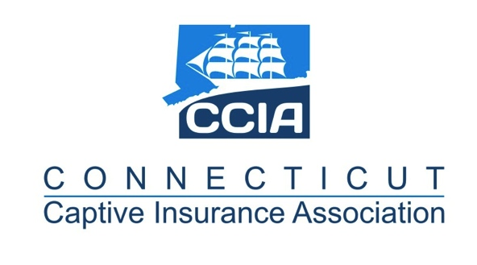
Why Captives Make Sense for Your Business
Thomas F.X. Hodson
President
Connecticut Captive Insurance Association
Gregory V. Serio
Executive Vice President
Charter Risk Management Services, LLC

Slide 7
Historical Perspective
The first organized sharing of risk was done by ship and cargo owners at Edward Lloyd’s coffee house in London in 1688
Strong evidence indicates that the first U.S. captive was the Mutual Assurance Company of the City of Norwich organized in Norwich, Connecticut in 1795 by textile manufacturers
First modern captive was the Mahoning Insurance Company, established by the Youngstown Sheet & Tube Company in 1957

Slide 8
Historical Perspective
By the end of the 1980’s, there were approximately 1000 captives worldwide
Until the late 1990’s, captives were mostly a vehicle used by large industrial companies
As a result of the development of rent-a-captives and cell companies in the early 2000’s, captives became more accessible to middle market companies and the captive market grew dramatically
As of 2012, there are more than 6,660 captives worldwide

Slide 9
Market Perspective
Global
  Number of captives worldwide- 6687
  Amount of worldwide premium- Estimated $90-$95 billion
United States
  Number of captives in the U.S.- 1959
  Amount of U.S. Premium- Estimated $42-$43 billion
Connecticut
  Number of captives- 2
  14 Fortune 5oo companies headquartered in the state
    13 of those companies have captives
      30 captives
*Statistics Courtesy of Captive Review

Slide 10
Market Perspective
Most Popular Coverages Written by Captives:
  Property
  General/Third Party Liability
  Employers’ liability/Workers’ compensation
  Professional Indemnity
  Automobile liability
  *Information courtesy of Marsh’s 2012 Captive Benchmarking Report

Slide 11
Market Perspective
Top 10 Ranking of Captive Utilization by Industry
  Financial Institutions
  Health Care
  Retail and Consumer Products
  Manufacturing
  Power and Utilities
  Construction
  Transportation
  Communications, Media and Technology
  Chemicals
  Mining, Metals and Minerals
  *Information courtesy of Marsh’s 2012 Captive Benchmarking Report

Slide 12
What is Captive Insurance?
Essentially, formalized self-insurance
A captive is an insurance company wholly owned and controlled by its parent company, association or group, to insure its own risk
The parent is the beneficiary of the captive’s underwriting profits
Represents an alternative to the traditional market with the benefits of true insurance

Slide 13
Which Companies are Good Candidates for a Captive Program?
Companies with:
  Financial stability
  Good spread of risk with predictable losses
  Good loss record
  Good risk management practices
  The ability to finance its own exposure
  Long-term commitment from senior management
  Unusual or hard-to-place risks
  Strong business partners
  Purpose other than tax benefits

Slide 14
Business Rationale for a Captive Program
Retain control over assets
Formalize risk retention financing
Improve coverage of risks
Reduce cost of financing loss
New profit center

Slide 15
Insurance Objectives for a Captive Program
Smooth the cyclicality of the insurance market
Capture underwriting profits
Tailor policies to company’s specific needs
Improve risk management through loss control
Reduce loss through improved claims management
Reduce insurance costs
Improve investment management of claim reserves
Increase tax savings opportunities

Slide 16
Risks of a Captive Program
Incurring unexpectedly large losses
Compliance issues
Low investment returns
Meeting and maintaining capital requirements
Accessing capital assets if necessary
Distributing profits
Difficulty in winding down program
Restrictions on selling or transferring ownership

Slide 17
Types of Captives
Pure/Single Parent Captive
Association/Group/Industrial Insured Captive
Sponsored (Segregated and Protected Cell) Captive
Special Purpose Financial Captive
Branch Captive
Risk Retention Group

Slide 18
Pure/Single Parent Captive
Owned 100% by its parent
Insures only the risks of related entities (parent, affiliates, subsidiaries and controlled unaffiliated business)
Represents the majority of captives worldwide- 75%-85%
Can be formed as a stock corporation, nonprofit corporation or limited liability company
Minimum capital and surplus required for licensing= $250,000

Slide 19
Pure/Single Parent Captive
Owned 100% by its parent
Insures only the risks of related entities (parent, affiliates, subsidiaries and controlled unaffiliated business)
Represents the majority of captives worldwide- 75%-85%
Can be formed as a stock corporation, nonprofit corporation or limited liability company
Minimum capital and surplus required for licensing= $250,000

Slide 20
Pure/Single Parent Captive
Reinsurer A
Parent
Captive
Reinsurer B
Reinsurer C

Slide 21
Pure/Single Parent Captive
Parent
(Holding Co.)
Subsidiary 2
Subsidiary 3
Subsidiary 1
Captive
Subsidiary 4

Slide 22
Association/Group/Industrial Insured Captive
Group captive can encompass different structures, including:
  Association
  Industrial Insured
Common among group captives:
  Ownership resides with unrelated entities or individuals
  Insures the members of the group
  Formed to capitalize on group “buying” power
  Shared results

Slide 23
Association/Group/Industrial Insured Captive
Association captives are sponsored and owned by trade, service or industry associations for the benefit of their members
  Need sufficient member participation
  Popular when certain coverages are unavailable or unaffordable
Industrial Insured captives are typically formed by two or more owners to insure similar risks in the same industry
Can be formed as a stock company, a mutual, a reciprocal or limited liability company
Minimum capital and surplus required for licensing= $500,000

Slide 24
Association/Group/Industrial Insured Captive
Association
Dividends
Owns/Capitalizes
Member
Captive
Member
Premiums
Member
Member
Insurance Policies
Member

Slide 25
Sponsored Captive
Generally, created by a “sponsoring” entity which could be a corporate parent, affiliate, or third party such as a captive manager, insurance company or insurance producer
Accounts (often referred to as “cells” or “protected cells”) are created through participant contracts, segregating the assets and liabilities of each account from the other accounts and from the sponsored captive’s general account
Account holders need not have any affiliation with the sponsors
Sponsor will charge a fee for services provided and use of capital
Advantages are ease of access, lower start-up costs and lower annual operating costs

Slide 26
Sponsored Captive
Sponsored captive can be formed as a stock or mutual corporation, a nonprofit or a limited liability company
Account (or “protected cell”) may be organized as a separate corporation or limited liability company with its own governing body and tax ID
Minimum capital and surplus required for licensing of sponsored captive= $500,000
Each account will be required to maintain some minimum level of capital and surplus, depending on nature and amount of risk

Slide 27
Sponsored Captive
Sponsor
100% of Stock
Participant
Contract
Participant
Contract
Sponsored Captive
Cell A
Cell B
Participant B
Participant A

Slide 28
Special Purpose Financial Captive
Allows securitization transactions by captive insurance company, thus transferring insurance risk to the capital markets
Provides captives with an alternative source of capital to address reserve requirements
The securitization requires two steps:
  Creation and licensing of a Special Purpose Financial Captive (“SPFC”), and
  Security offering

Slide 29
Special Purpose Financial Captive
A typical SPFC securitization includes:
  SPFC selling debt to a capital market underwriter who converts the debt into money market securities for sale to institutional investors
  Parent, or counterparty, cedes risk to the SPFC for a specified premium, usually in the form of reinsurance
  Premium, investment income and other revenue sources fund the debt instruments
  Proceeds of the securitization are held in trust and used to fund required reserves
  Trust funds provide credit for reinsurance and pay the ceded obligations
SPFC may be organized as a pure/single parent captive or a sponsored captive
Minimum capital and surplus required for licensing= $250,000

Slide 30
Branch Captive
Typically a subsidiary or affiliate of an alien (offshore) captive, therefore a “branch” of an existing captive
Formed and regulated much like a pure/single parent captive
A branch captive is used in situations where parent of an offshore captive wants to insure risks which can only be written in a U.S. based insurance company (i.e. employee benefits regulated under ERISA)
Parent creates an onshore branch of its offshore captive rather than forming a new U.S. based captive in order to achieve capital and operating efficiencies
Minimum capital and surplus required for licensing= $250,000

Slide 31
Risk Retention Group
Special form of group risk sharing entity created pursuant to the federal Liability Risk Retention Act of 1986
Regulated by Connecticut under its captive statute
Risk Retention Groups (“RRG’s) operate like group captives
Federal law allows RRG’s to operate in all 50 states even though only licensed in the state of domicile

Slide 32
Risk Retention Group
Restricted to covering only liability risks of its members
Operationally more complex and costly to run than group captives
Can be formed as a stock or mutual insurer, reciprocal or limited liability company
Minimum capital and surplus required for licensing= $1 million

Slide 33
Types of Programs
Fronted Program
  Captive partners with a licensed carrier to issue policy(ies)
  Captive acts as a reinsurer
  Advantages are experience, ease, speed, access to quality aggregate reinsurance, fewer regulatory compliance issues for captive
Direct Written Program
  Captive issues insurance policy(ies)
  Advantages are control over program, ability to tailor policy/coverages to a greater degree

Slide 34
Steps to Forming a Captive
Conduct a Feasibility Study to include:
  Cost benefit analysis
  Actuarial analysis.
  Financial projections
  Tax analysis
  Preliminary Business Plan-
    Business case
    Coverage lines, limits, rules, rates and policy types
    Captive legal structure analysis
  Review of current insurance program
  Reinsurance program
  Review of historical loss data

Slide 35
What Makes a Good Captive Domicile
Strong state commitment to captive market
Knowledgeable service sector
Geography
State-of-the-art captive law
Strong trade group

Slide 36
Why Connecticut?
200+ year old heritage as the “Insurance Capital” of the U.S.
Home to more service providers, fronting carriers and reinsurers dedicated to the captive industry than almost any other US domicile
Convenient location at the crossroads of the Northeast
State government has identified the captive marketplace as a huge growth opportunity for the state and is dedicating tremendous resources to develop Connecticut as a first class domicile
Ranks #1 in the U.S. in insurance jobs per capita
Ranks #1 in the U.S. in life premiums written
Ranks #2 in the U.S. for ALL premiums written

Slide 37
Why Connecticut?
Favorable Captive Law
  Permits formation of all types of captives
  Application fees are significantly lower than many of the popular U.S. domiciles
  Competitive initial capital and surplus requirements
  Competitive annual tax rates
    Unique $7,500 credit against first year premium taxes
  Flexible annual reporting requirements
  Uniform examination schedule for all captives
  Exam costs are limited

Slide 38
Contact Information
Thomas F.X. Hodson
Connecticut Captive Insurance Association
tfxhodson@ConnCaptives.org
Charter Risk Management Services, LLC
tfxhodson@charterriskmanagement.com
(860)614-3656
Gregory V. Serio
Charter Risk Management Services, LLC
gserio@charterriskmanagement.com
(518) 426-3480

Slide 40
Captives and Taxes
Everything You Need To Know
(in 20 minutes or less)
Presented by:
Richard Buggy, J.D., LL.M., CPA
Saslow Lufkin & Buggy, LLP
October 5, 2012
Captive Insurance Symposium

Slide 41
Discussion Highlights
Where’s the Action?
Basic Captive Tax Concepts
IRS Perspectives
State Taxes and Captives
Impact of Dodd-Frank on Captives
Other Tax Trends and Topics

Slide 42
Where’s the Action?
Single Parent Captives
Group & Association Captives
Small & Special Purpose Captives
Cell Captives & “Series” Captives

Slide 43
Basic Concepts
Tax Advantages of Captives
Is it “Insurance”?
Risk Shifting & Risk Distribution
Pure “Self Insurance” Distinguished

Slide 44
Tax Advantages & Benefits
Deduction of Premiums Paid
Deduction for Loss Reserves
State Income Tax Relief
Small Insurance Company Benefits

Slide 45
Is it “Insurance”?
State Regulation NOT Determinative
Starting Point:
  Legitimate Business Purposes
  Legitimate Risk Management Needs
  Feasibility Study
Acts Like an Insurance Company
The “More-Than-Half” Test

Slide 46
Is it “Insurance”?
Risk Shifting
  Someone Else Paying Your Loss
  Risk Shifting Among Related Parties
Risk Distribution
  Sufficient Number of Insured Parties
  How Many?

Slide 47
IRS Perspectives
1970s, 1980s and 1990s:
“Economic Family” Theory
Revenue Ruling 2001-31: Concession
IRS “Safe-Harbor” Rulings
Proliferation of Captives (2002 –present)
Current Battleground

Slide 48
State Taxes
State Premium Taxes
Premium Taxes “In Lieu of” Other Taxes
Connecticut Premium Tax on Captives
Connecticut Investment Incentives
Self-Procurement Taxes

Slide 49
Dodd-Frank Act
Nonadmitted and Reinsurance Reform Act of 2010 (“NRRA”)
Goal: Surplus Lines Tax Efficiency
Application to Captives
“Home State” Taxation Only
State Tax Compacts to Share Revenue

Slide 50
Other Tax Topics & Trends
Federal Excise Tax on Offshore Insurance or Reinsurance
On-Shore Redomestications
Micro-Captives
“Pooling” Companies/Mechanisms

Slide 51
Thank You For
Attending

Slide 52
Contact Information:
Saslow Lufkin & Buggy, LLP
Certified Public Accountants and Consultants
Richard Buggy, Managing Partner Glenn Saslow, Director of Insurance
rbuggy@slbcpa.com gsaslow@slbcpa.com
10 Tower Lane
Avon, CT 06001
(860) 678-9200
30 Main Street
Burlington, VT 05401
(802) 865-9300
www.slbcpa.com

Slide 54
John Thomson
Manager Insurance Programs– Captive Insurance,
Connecticut Insurance Department

Slide 56
CCIA Educational Forum
Captive Formation in
Connecticut
Presented by
Theodore P. Augustinos, Partner
Edwards Wildman Palmer LLP
October 5, 2012

Slide 57
Agenda
Choice of Captive
Lines of Business
De Novo or Redomestication of Existing Captives
Legal and Regulatory Process
Interesting Issuers and Challenges

Slide 58
I. Choice of Captive
Pure
Association
Industrial Insured
Risk Retention
Plus, added by the new law:
  Sponsored
  Special Purpose Financial
  Branch

Slide 59
II. Lines of Business
Life
Annuity
Health
Commercial Risk
Plus, added by the new law:
  Any line not prohibited
  No auto or homeowners

Slide 60
III. De Novo or Redomestication
Redomestication law doesn’t apply to captives. Therefore, even a Redomestication will require a de novo organization of a Connecticut captive.
Once the Connecticut captive is organized,
  Merger of existing captive from another jurisdiction into new CT captive
or
  Assumption Transaction to move business from existing captive into CT captive.
Merger can provide the capital.
Out-of-state approvals may be required for various elements of the transaction.
Tax issues may drive the decision.

Slide 61
IV. Legal and Regulatory Process
Assemble the team of internal and external resources
  Business and operations
  Tax
  Legal
If redomesticating, don’t forget the existing captive.
  Consider existing issues
    Business and Operations, including contractual requirements and consents.
    Out-of-State legal and regulatory issues
Meet with Department
  Discuss strategy, timing, process and business plan
Name selection, reservation and approval
Prepare Application and Plan of Operations
  Feasibility Study
Approvals and Filings

Slide 62
V. Interesting Issues
Transfer of Existing Reinsurance
  Credit for Reinsurance – eligible reinsurers
  Consent of Reinsurers
Capitalization of Captive
  Contribution of Capital
    Directly – Dividend issues?
    Through merger
  Timing for Capital Contribution
Tax Issues
  Deductibility of Premiums and the Brother-Sister Issue
  Tax Ramifications of moving business from existing captives.

Slide 64
CCIA Educational Forum
Captive Life Cycle
Presented by:
Steve DiCenso, FCAS, MAAA,
Principal and Consulting Actuary, Milliman
October 5, 2012

Slide 65
Captive Life Cycle
Pre-Feasibility Process
Feasibility Study
  Legal and Tax Considerations
  Domicile Analysis
  Actuarial Analysis
  Pro Forma Financial Statements
On-Going Work
Q&A
My
Focus
Today

Slide 66
Pre-Feasibility Process
  Define Captive Objectives
  Design Captive Program (i.e., coverages, limits, premiums, reinsurance, etc.)
  Evaluate Domicile
  Evaluate Captive Service Providers
  Evaluate Fronting Carrier, as required
  Develop Captive Business Plan

Slide 67
Feasibility Study
Why?
What?
Evaluation of Results

Slide 68
Why a Feasibility Study?
    Must forecast risk to measure viability:
      Is captive the right vehicle to use?
      Policy limit captive to be offered
      Amount of premium to charge
      Amount of capital to support adverse results and meet regulatory requirements
    Helps to identify potential advantages and the potential risks of operating a captive insurance company
    Likely required for licensing/application process
    Likely required for presenting to the reinsurance market

Slide 69
Feasibility Study
Components of Captive Actuarial Feasibility Study
  Estimate losses
  Estimate expenses
  Develop rates/funding levels
  Establish appropriate capital levels
    Predict risk
    Consider Variability and Impact on Risk Appetite
  Prepare pro forma financial statements
  Expected and alternative scenarios
  Calculate economic benefit (profit/tax savings vs. costs, including opportunity cost of capital)
Notes:
This is my bread & butter
Pro-formas are 5 years: BS, IS, CF
Some states ok with Expected vs. Adverse, but better to do on statistical basis using
Confidence levels – span entire risk spectrum

Slide 70
Some Details of What’s Needed
    Company specific
      Goals; Constraints
    Operational
      Management (claims and risk)
      Coverage Terms/Conditions
    Loss Information
      Detailed claim runs, including outliers
    Exposures
      Historical and prospective (payroll, vehicles, sales, etc.)
      Descriptions/locations
    Prospective Expenses

Slide 71
Loss Analysis
    Actuarial Analysis of Past Loss Experience
      Actuarial Adjustments (e.g., development, trend, etc.)
      Internal Factors (e.g., loss control)
      External Factors (e.g., laws)
    Projection of First Year Captive Experience
      Loss Rate = Losses per unit of Exposure
      Expected Losses = Loss Rate x Expected Exposures
      Confidence Levels/Contingency margin

Slide 72
Expense Analysis
    Fronting Fees
    Reinsurance
    Claims Administration, Loss Prevention
    Commission & Brokerage
    Management Fees
    Legal, Audit, Actuarial, & Consulting
    Letter of Credit
    Other (Travel, Board Meeting, D&O)
    Taxes & Assessments

Slide 73
Other Assumptions
(for Pro Forma Financial Projections)
    Premium Growth
    Capitalization - Amount and Form
    Rate of Return on Investments
    Loss Payout Pattern
    Income Taxes
    Adverse Scenario

Slide 74
Pro Formas
    Financial Analysis
      Expected vs. Adverse loss scenarios
      Various attachment points
      Various reinsurance structures
    Prospective pro forma financial statements
      5 year prospective financial statements
        income statement
        balance sheet
        cash flow
      Expected incorporation and ongoing expenses
      Investment return modeling
      Surplus and capital contributions

Slide 75
Evaluation of Results
    Adequacy of Capital
    Adequacy of Reserves (for LPT)
    Adequacy of Premium
    Financial Strength Measurements
      See next slide

Slide 76
Financial Strength Measures
Key Financial Ratios
  Solvency ratio (NWP/surplus)
  Loss reserve ratio (Reserves/surplus)
  Retention ratio (Surplus/max net retention)
  Risk gap (Unfunded risk/surplus)
    Unfunded Risk = Limit – (Premiums + Surplus)

Slide 77
Ongoing Captive Work
    Annual Loss Reserve Opinion in CT
    Annual Audit
    Change in Business Plan
    Updated Premium Projections
    New Coverage Analyses
    Retention / Reinsurance Analysis
      Analyze Dynamically based on Company and Marketplace Changes
    Capital Analysis
    Cost Allocation
    Dividends

Slide 78
Other Actuarial Issues
Discounting Loss Reserves
Loss Reserve Ranges/Confidence Levels
Reinsurance Collectability
Risk Transfer

Slide 79
Q&A
Questions?

Slide 81
CCIA
Captive Symposium
October 5, 2012
Angella Stelly, Risk Manager, Stanley Black & Decker, Inc, New Britain, CT
Michael Serricchio, SVP, Marsh Captive Solutions,
Norwalk, CT

Slide 82

Agenda
Introductions
Worldwide Captives
Connecticut’s Captives
Stanley Black & Decker, Inc.
SBD Insurance, Inc.
Why Connecticut
What’s Next for SBD Insurance, Inc.

Slide 83
Marsh Captive Solutions Group
Number of Captives Worldwide
Source: BI Survey, “Top Captives Worldwide,” Business Insurance, March 5, 2012: 9
*2010 has been restated

Slide 84
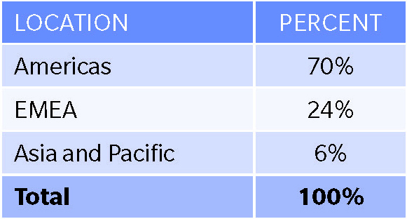
2012 Captive Benchmarking Report
Captive Ownership by Location of Owner
Most of our benchmarked captives are owned by one entity.
Most are headquartered in the Americas, followed by EMEA, with a relatively small percentage in Asia and Pacific.
Approximately 85% of Fortune 500 Companies have at least 1 captive

Slide 85
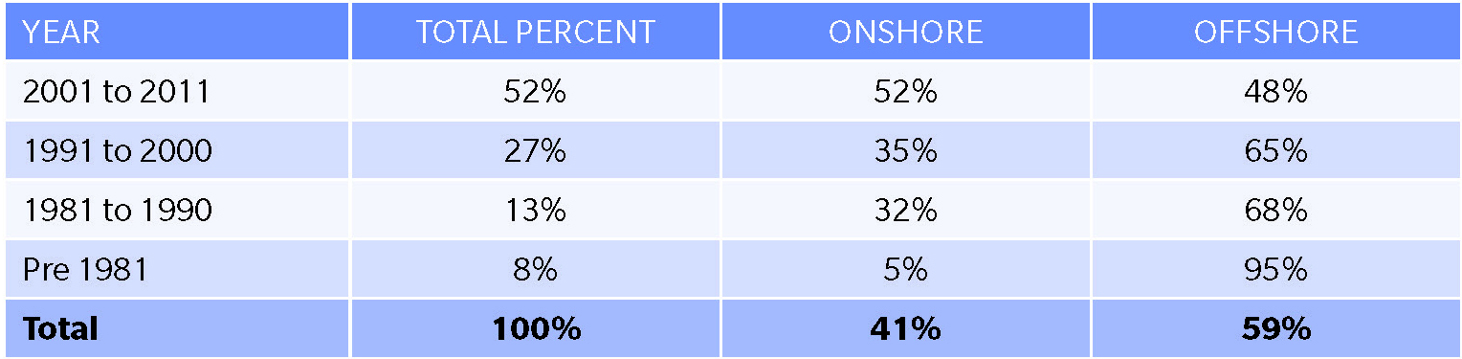
2012 Captive Benchmarking Report
Captive Formation Comparison - Onshore vs. Offshore
Organizations are more likely to form new captives onshore in the U.S. or EU.
From 1991 to 2000, 65 percent of the captives formed were domiciled in offshore locations including Bermuda, Cayman Islands, Guernsey, and Isle of Man, while 35 percent stayed onshore.
That trend reversed during the last decade: 52 percent of the captives formed from 2001 to 2012 were established onshore, compared to 48 percent offshore.

Slide 86
U.S. Domestic Captive Domiciles
September 2012
Captive Domicile / Number of Captives
2 Captives licensed in 2012
Alabama 18
Arizona 97
Arkansas 1
Colorado 5
Connecticut 2
Delaware 150
District of
Columbia 157
Florida 0
Georgia 13
Hawaii 172
Illinois 1
Kansas 1
Kentucky 137
Louisiana 0
Maine 2
Michigan 5
Missouri 19
Montana 83
Nevada 127
New Jersey 3
New York 50
Oklahoma 1
Rhode Island 0
South Carolina 159
South Dakota 4
Tennessee 4
USVI 8
Utah 239
Vermont 590
Virginia 0
West Virginia 1
WA
MT
ND
NH
MN
ME
OR
ID
SD
WI
VT
WY
IA
MI
NY
MA
NE
IL
IN
OH
PA
RI
NV
UT
CO
KS
MO
WV
NJ
CT
CA
VA
KY
DE
OK
TN
NC
MD
AZ
NM
AR
SC
MS
AL
GA
DC
TX
LA
FL
AK
HI
Captive statutes
No specific captive statutes

Slide 87
Domicile Analysis
Global Captives Year End 2011
Active Captives by Domicile for Year-End 2011
Total Active Captives: 5,746
Source: Business Insurance Magazine, March 2012

Slide 88
Connecticut’s First 2 Captive Insurance Companies
Thomson Reuters Corporation
  Thomson Reuters Risk Management, Inc. (TRRMI)
    Licensed August 31, 2012
      Re-domesticated from Delaware to CT based on the new advantageous captive laws, to be closer to home and for cost synergies
      Various fronted and direct written property & casualty coverages such as:
        Primary casualty;
        TRIA;
        Personal accident/travel for global employees.

Slide 89
Stanley Black & Decker, Inc,
Stanley was formed in 1843 by Frederick Stanley in New Britain, CT.
In 1910, S. Duncan Black and Alonzo G. Decker started their company in Baltimore, Maryland.
Stanley Works merged with Black & Decker in March 2010,in a historic and impressive combination of brands, products, and industry expertise.
Headquartered in New Britain, CT
Publically traded on the New York Stock Exchange (SWK)
37,955 Employees
  13,209 in US
    1,388 in Connecticut

Slide 90
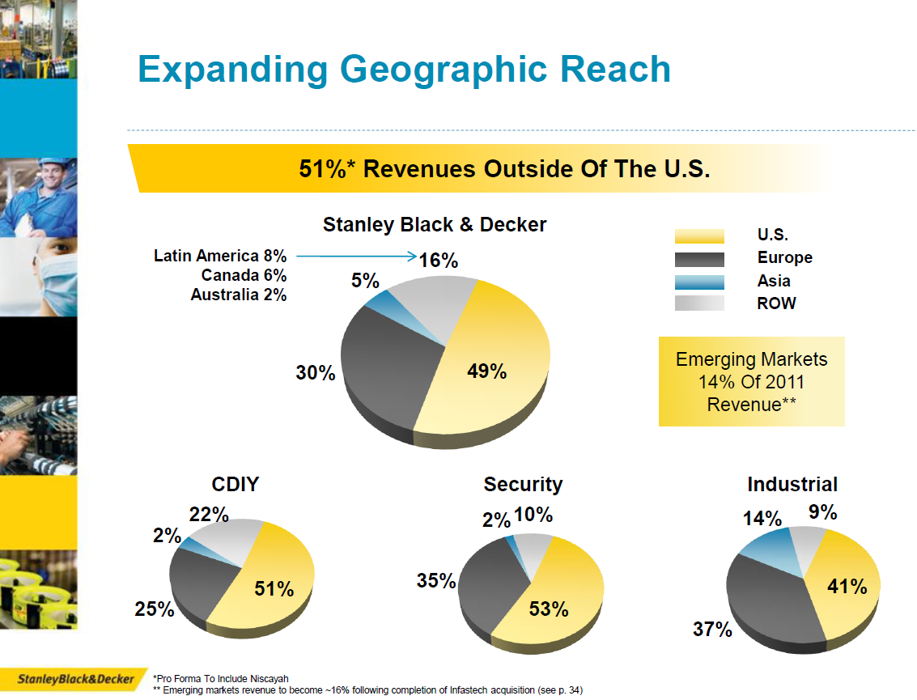
Q&A
Thank You

Slide 91
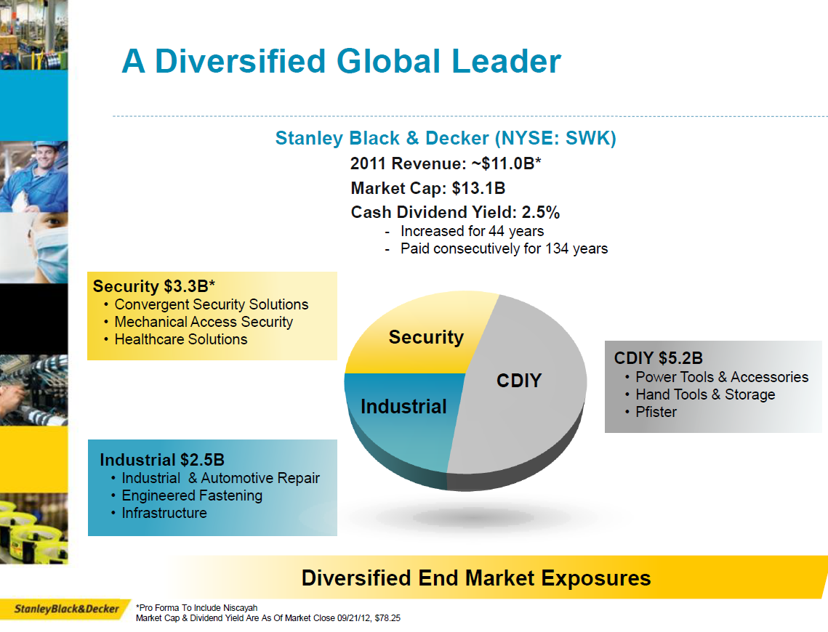

Slide 92
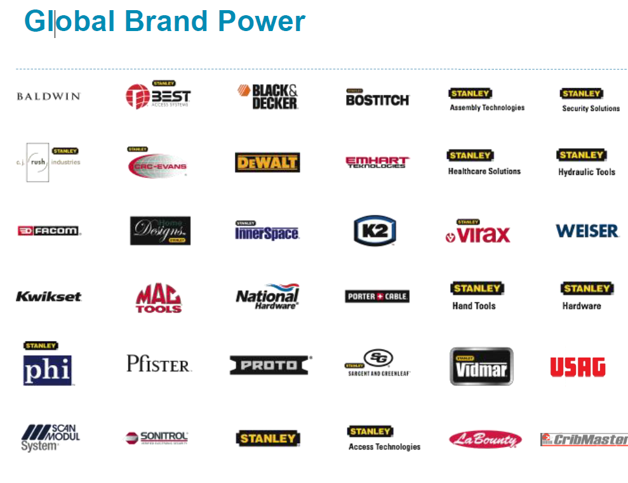

Slide 93
SBD’s Captives Pre – Consolidation
Stanley Black & Decker, Inc.
100% Ownership
The Stanley Works (Bermuda) Ltd.
Baltimore Insurance Limited
Shenandoah Insurance, Inc. (VT)

Slide 94
SBD’s Captives Post – Consolidation
Stanley Black & Decker, Inc.
100% Ownership
SBD Insurance, Inc. (Connecticut)

Slide 95
SBD Insurance, Inc.
Stanley Black & Decker, Inc.
  SBD Insurance, Inc.
    Licensed September 5, 2012
Insures SBD and Independent Contractors for:
  Workers’ Compensation
  General/Product’s Liability
  Automobile Liability
  MAC Tool Distributors Property/Casualty risks

Slide 96
Why Connecticut? Advantages
Proximity to SBD Operations
  Very efficient, economical, no travel required, lower vendor costs
  Captive’s office could be in SBD’s New Britain, CT building
Easy to move from VT to CT and Bermuda to CT
Regulatory Climate
  Although a newer domicile, The CT captive Regulatory staff is responsive to client requests
Experience of jurisdiction
  Insurance capital of the US
Capitalization/ Surplus Requirements
  Similar to most others, $250,000 in cash required
Captive Laws, Investment Restrictions, Reporting, Accounting, Auditing Requirements
Flexible, similar to other domiciles
Underwriting Limitations
  Very little restrictions on what can be written, similar to most other domiciles
Income, Local, and Self Procurement Taxes
  CT State premium tax similar to other US domiciles

Slide 97
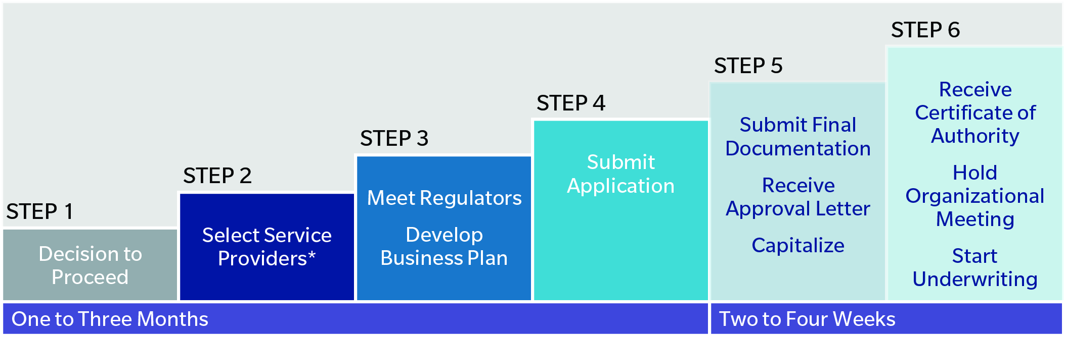
Building a Captive Program in Connecticut
Including selection of captive manager, auditor, attorney, bank, actuary,
asset manager and tax advisors (optional)

Slide 98
What’s Next for SBD Insurance, Inc.
Expand current property & casualty program
  Workers’ Compensation
Merge Bermuda captive with CT Captive
Continue to look for opportunities to reduce costs and efficiently use the captive
Efficient use of SBD’s capital
Other opportunities in a hard insurance market
Other 3rd party offerings for the captive in the future

Slide 99

