Slide 1
Exit Strategies for Captives
Carolyn Fahey, AIRROC
Thomas F.X. Hodson, SOBC DARAG
Steve McElhiney, EWI Re
Michael Terelmes, Sirius Global Solutions
Notes:
CF to briefly introduce panel

Slide 2
Runoff and Legacy
Runoff…yesterday’s underwriting
Non-core, discontinued, no-premium, etc.
Strategic opportunities for finality
Ability to release trapped capital
AIRROC’s role
Notes:
CF Lead – other panelists can add brief “perspectives”
Runoff or Legacy is the term used to broadly describe the process an Insurance / Reinsurance company follows when it has a block of business, for which it makes future plans for handling the liability (expected future claims that it expects to pay and for which a reserve has been established) and is not supported similarly to “ongoing business.”
“All lines of business where premiums are no longer being written.”
Strategic exits -- Better alignments of risk appetites to capital providers
Emergence of Run-off Capital as an alternative and permanent risk funding source
“Any discontinued line of business.” -- “Business that is being wound down and no longer underwritten.”
“Closed book of business with no more underwriting.” -- “2001 and prior.”
“Discontinued companies, affiliates or segments.”
“Non-core to the group.”
“No new written business.”
Strategic Opportunities for Ongoing Captive Finality Solutions
Laser liabilities from captives (retained risks) – Risk mitigation strategy
Transfer risk to a counterparty with a different risk tolerance, willing to take on the tail risks
Established in December 2004, AIRROC's membership includes companies with discontinued lines of business, insolvent run-off, brokers, legacy acquirers and managers, and state insurance departments. An approach of “by the members for the members” to address common business issues and interests is the primary objective of AIRROC. How we do this: events, highlight what makes AIRROC a productive business tool. All panelists are from AIRROC members – give them opportunity to discuss how AIRROC works for their business

Slide 3
Easy In…Not So Easy Out
Regulated industry
Active captives
Dormant captives
Captives and RRGs with legacy liabilities
Notes:
There are plenty of service providers and regulators willing to help captives enter the space
Exiting is a different story
7000 global captives
2000 dormant captives worldwide - – an excellent universe for finality transactions – one where we have had success
The captive space is not transparent

Slide 4
Reasons for Exit
Result of M&A
Change of purpose
Parent company changes
Unaware of “finality solutions”
Non insurance people in the process
Notes:
SM lead – others add commentary
PANEL give CF ideas for a question that I can ask to transition to next topic

Slide 5
Solutions for Captives and RRGs
Adverse Development Covers
Loss Portfolio Transfers
Assumption Agreements
Commutations
Novations
Sales
Notes:
TH Lead – all can add commentary
CF to ask at end for examples of places where each have seen one of these benefit a captive (if possible) or just a company in general. Transition to next discussion item

Slide 6
Underwriting the Transaction
Actuarial
Develop expected ultimate losses and required reserves
Project a payment pattern
Project range of possible outcomes
Calculate the fair value of the reserves
Notes:
MT to lead

Slide 7
Underwriting the Transaction
Claims & Financial
Ground up claim review
Reinsurance asset analysis
Runoff administration analysis
Cash flow modeling
Notes:
MT to lead – If you have a captive and want to get rid of all or part of it what do you need to do??

Slide 8
Closing the Transaction
Legal and Regulatory
Definitive documents
Regulatory filings
Notes:
TH to Lead

Slide 9
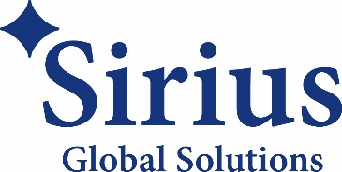
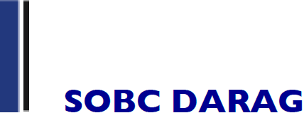
Contact Information
Carolyn Fahey carolyn@airroc.org
Steve McElhiney smcelhiney@ewiretx.com
Michael Terelmes
Michael.Terelmes@siriusgroup.com
Thomas Hodson
Thomas.Hodson@sobcdarag.com

